Slide 1
Greek Mythology in Hesiod

Slide 2
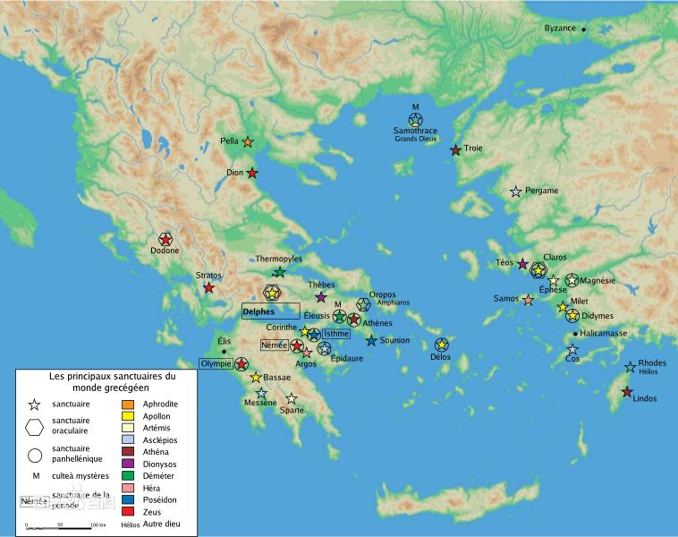
Ancient Greece

Slide 3
The history of Greece can be traced back to Stone Age hunters. Later came early farmers and the civilizations of the Minoan and Mycenaean kings. This was followed by a period of wars and invasions, known as the Dark Ages. In about 1100 BC, a people called the Dorians invaded from the north and spread down the west coast. In the period from 500-336 BC Greece was divided into small city states, each of which consisted of a city and its surrounding countryside.

Slide 4
Time Periods
NEOLITHIC PERIOD | (6000 - 2900 BC)
EARLY BRONZE AGE | (2900 - 2000BC)
Minoan Age | (2000 - 1400 BC )
MYCENAEAN AGE | (600 - 1100 BC)
The Dark Ages | (1100 - 750 BC)
Archaic Period | (750-500BC)
Classical Period | (500-336 BC)
Hellenistic Period | (336-146 BC)

Slide 5
NEOLITHIC PERIOD (6000 - 2900 BC)
According to historians and archeological findings, the Neolithic Age in Greece lasted from 6800 to 3200 BC. The most domesticated settlements were in Near East of Greece. They traveled mainly due to overpopulation. These people introduced pottery and animal husbandry in Greece. They may as well have traveled via the route of Black sea into Thrace, which then further leads to Macedonia, Thessaly, Boeotia etc. The second way of traveling into Greece is from one island to another and such type of colonies has been found in Knossos and Kythnos.
The main characteristics of this era are the climate stabilization and the settlements of people. The Neolithic Revolution arrives with these people who traveled from Anatolia, Turkey. The economy of the region became steady with organized and methodical farming, stock rearing and, bartering and sculptures like pottery. People stopped traveling from region to region and permanent settlements in Greece. They domesticated animals like sheep and goats and grew plants and crops. They made their bases around sites where there was ample water supply and in open landscapes. The Neolithic Greece people can be said as the first 'farmers' and their lives were less complex and simple.

Slide 6
EARLY BRONZE AGE (2900 - 2000BC)
The Greek Bronze Age or the Early Helladic Era started around 2800 BC and lasted till 1050 BC in Crete while in the Aegean islands it started in 3000 BC. The Bronze Age in Greece is divided into periods such as Helladic I, II. The information that is available today on the Bronze Age in Greece is from the architecture, burial styles and lifestyle. The colonies were made of 300 to 1000 people. The Bronze Age is known as so because of the invention and introduction of the metal bronze. This metal made its entry into Greece in 3000 BC, but it did not make its impact as soon as it arrived. The people from Dimini from the Neolithic era that had settled in Greece slowly started the use of Bronze. Knives and swords were carved from the metal. This metal was more easy to use than stone, bone or wood. Metals such as gold, silver and lead arrived at the same time as bronze.
The class system in society started with the arrival of metal depending on their value and availability. Bronze was expensive and copper was to be brought from other areas. The richer class could afford the metals and this was proved by the excavations found wherein people where buried with metal jewelry.

Slide 7
Minoan Age(2000 - 1400 BC )
Bronze Age civilization, centring on the island of Crete. It was named after the legendary king Minos. It is divided into three periods: the early Minoan period (c.3000-2200 B.C.), the Middle Minoan period (c.2200-1500 B.C.) and the Late Minoan period (c.1500-1000 B.C.).

Slide 8
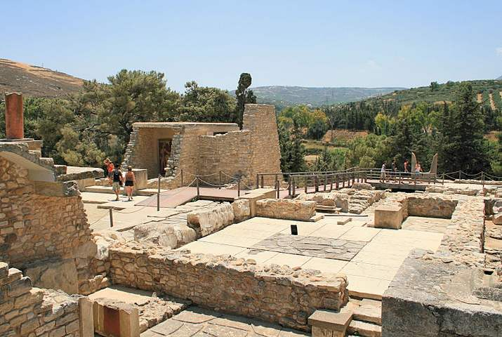
The labyrinth of Minos

Slide 9
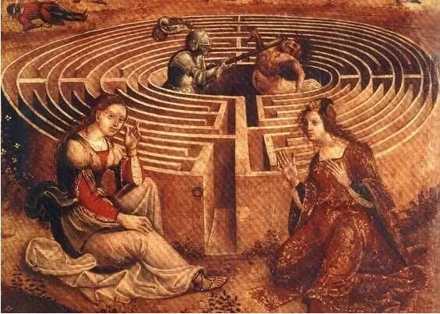

Slide 10
MYCENAEAN AGE (600 - 1100 BC)
The Mycenaean Age dates from around 1600 BC to 1100 BC, during the Bronze Age. Mycenae is an archaeological site in Greece from which the name Mycenaean Age is derived. Mycenae site is located in the Peloponnese, Southern Greece. The remains of a Mycenaean palace were found at this site, accounting for its importance. Other notable sites during the Mycenaean Age include Athens, Thebes, Pylos and Tiryns. According to Homer, the Mycenaean civilization is dedicated to King Agamemnon who led the Greeks in the Trojan War. The palace found at Mycenae matches Homer's description of Agamemnon's residence. The amount and quality of possessions found at the graves at the site provide an insight to the affluence and prosperity of the Mycenaean civilization. Prior to the Mycenaean's ascendancy in Greece, the Minoan culture was dominant. However, the Mycenaeans defeated the Minoans, acquiring the city of Troy in the process, according to Homer's Illiad (some historians argue this is Myth rather than fact).

Slide 11
Mycenaean culture was based around its main cities in Mycenae, Tiryns, Pylos, Athens, Thebes, Orchomenos, and Folksier. The Mycenaeans also inhabited the ruins of Knossos on Crete, which was a major city during the Minoan era. Mycenaean and Minoan art melded, forming a cultural amalgamation that is found on Crete (figurines, sculptures and pottery). During the Mycenaean civilization the class diversification of rich and poor, higher classes and lower became more established, with extreme wealth being mostly reserved for the King, his entourage and other members of the royal circle. Like the Minoans, the Mycenaeans built grand palaces and fortified citadels, with administrative and political powers firmly under royal authority. Mycenaean society was to some extent a warrior culture and their military was ever prepared for battle, be it in defence of a city or to protect its wealth and cultural treasures.

Slide 12
The Mycenaeans were bold traders and maintained contact with other countries from the Mediterranean and Europe. They were excellent engineers and built outstanding bridges, tombs, residences and palaces. Their tombs known as 'beehive tombs' were circular in shape with a high roof. A single passage made of stone led to the tomb. A variety of possessions, including arms and armour, were buried with the dead, while the more affluent might also be buried with gold and jewellery. Interestingly, rather than being buried in a sleeping position, Mycenaeans were interred in a sitting position, with the richer classes sometimes being mummified. The Mycenaeans invented there own script known as Linear B, which was an improved derivative of Linear A (a language commonly accepted as Minoan or Eteocretan).

Slide 13
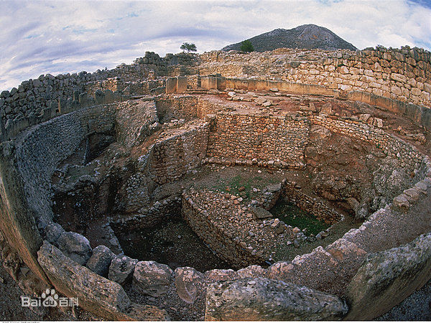

Slide 14
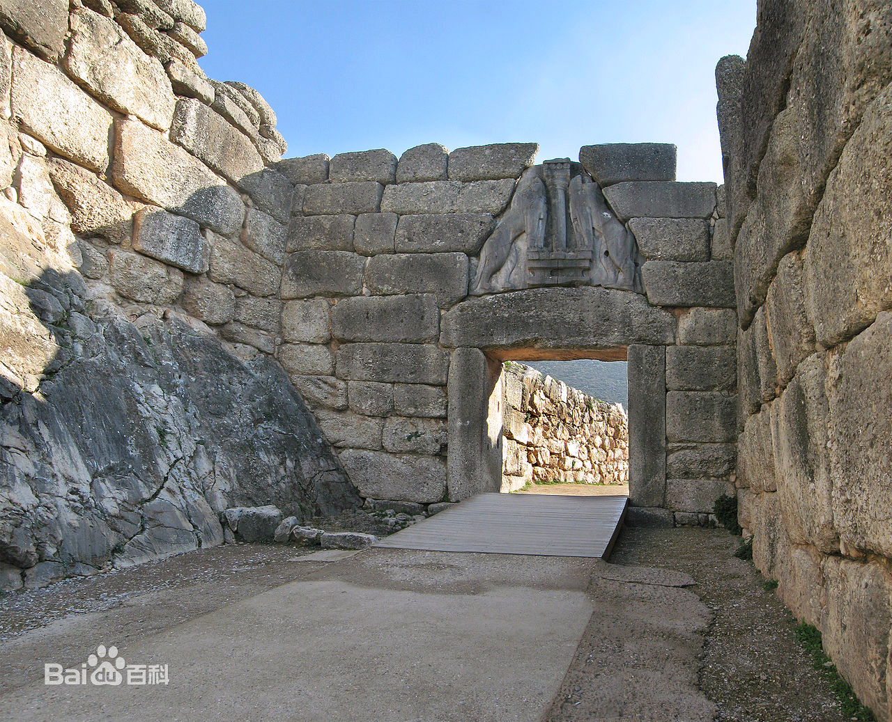
The Lion Gate

Slide 15
The Dark Ages (1100 - 750 BC)
The period between the fall of the Mycenean civilizations and the readoption of writing in the eigth or seventh century BC. After the Trojan Wars the Mycenaeans went through a period of civil war, the country was weak and a tribe called the Dorians took over. Some speculate that Dorian invaders from the north with iron weapons laid waste the Mycenaean culture. Others look to internal dissent, uprising and rebellion, or perhaps some combination.

Slide 16
The Dark Ages were as unenlightening as they may sound. They brought about the solidification of the Greeks' religion, mythology and founding history. The Greek people no longer lived in cities, after the collapse of the Mycenaean civilization (known as the "fall of the palaces"), but instead they formed small tribes. Some of these tribes were sedentary and agricultural, whereas others were nomadic and traveled Greece throughout the seasons. However these small tribes began to form one of Greece's greatest political achievements: the 'polis', meaning the city-state, which is what the word 'politics' is derived from.

Slide 17
The Dorians
Legends which survived among the Dorians and which have come down to us through Pindar, Herodotus and other ancient writers, say that the earliest ancestors of the Dorians were Makednoi (that is, Macedonians), who migrated to Doris from Pindos, more precisely from the Lakmos region. Since it has already been seen that the Dorians took their name from Doris, where they formed themselves into one ethnic group by the union of the local inhabitants and the newcomers, it can readily be inferred that the name Makednoi and the mention of Pindos as their original homeland do not refer to the whole of the Dorian tribe but just to one of its component groups - not the Hylleis, however, because these had settled in present-day Sterea Hellas earlier.

Slide 18
Ancient texts containing echoes of fragments of a very old lost epic about Aigimios say that the Dorians stood in danger of attack by the Lapiths, that the king of the Dorians, Aigimios, sought the help of Herakles in return for the reward mentioned above, and that Herakles repulsed the Lapiths and established the Dorians in a region from which he had driven out the Dryopians. It follows that the race which was led by Aigimios and helped by Herakles was not yet the Dorians but the Makednians. Herakles here is no more than the representative of a people in central Sterea Hellas. One of the texts mentioned above says that Aigimios people at the time of the Lapith attacks were in Histiaiotis; others imply that they had already reached the northern part of present-day Sterea Hellas. The second version must be the earlier one, because it tallies with the mention of the alliance of the people who are represented by Herakles. The mention of the Lapiths as enemies of the Dorians, i.e. the Makednians, does not conflict with this version since, as we have seen, there are traces of Lapith settlements in the Spercheios Valley.

Slide 19
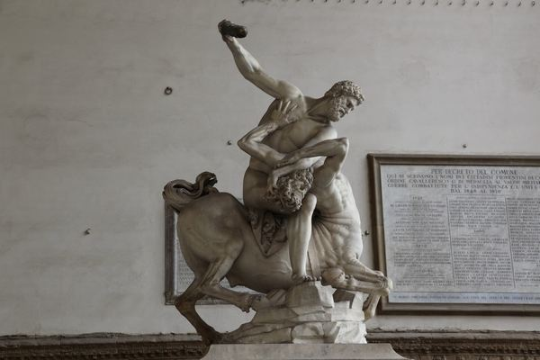

Slide 20
THE ARCHAIC PERIOD the years between 750 and 480 B.C., more particularly from 620 to 480 B.C.
The age is defined through the development of art at this time, specifically through the style of pottery and sculpture, showing the specific characteristics that would later be developed into the more naturalistic style of the Classical period. The Archaic is one of five periods that Ancient Greek history can be divided into; it was preceded by the Dark Ages and followed by the Classical period. The Archaic period saw advancements in political theory, especially the beginnings of democracy, as well as in culture and art. The knowledge and use of written language which was lost in the Dark Ages was re-established.

Slide 21
Classical Period (500-336 BC) -
Classical period of ancient Greek history, is fixed between about 500 B. C., when the Greeks began to come into conflict with the kingdom of Persia to the east, and the death of the Macedonian king and conqueror Alexander the Great in 323 B.C. In this period Athens reached its greatest political and cultural heights: the full development of the democratic system of government under the Athenian statesman Pericles; the building of the Parthenon on the Acropolis; the creation of the tragedies of Sophocles, Aeschylus and Euripides; and the founding of the philosophical schools of Socrates and Plato.

Slide 22
Hellenistic Period (336-146 BC)
Period between the conquest of the Persian Empire by Alexander the Great and the establishment of Roman supremacy, in which Greek culture and learning were pre-eminent in the Mediterranean and Asia Minor. It is called Hellenistic (Greek, Hellas, "Greece") to distinguish it from the Hellenic culture of classical Greece.

Slide 23
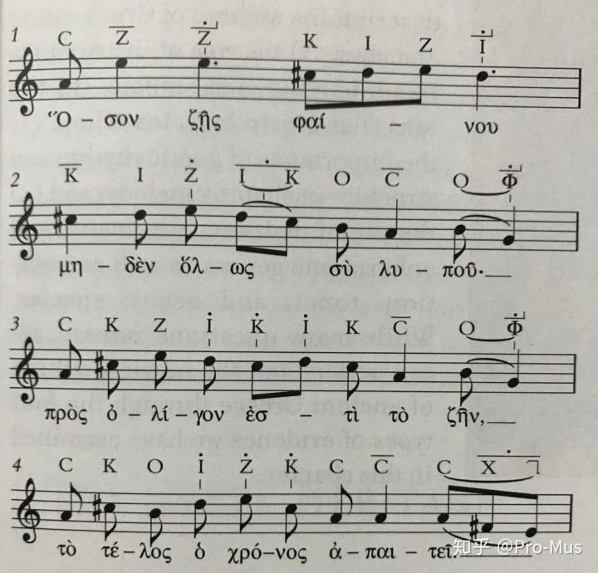
塞基洛斯的 墓志铭
只要你还活着， 就轻松愉快一些吧。 让你的一切都无忧无虑。 生命太短暂了， 时间使它消亡。

Slide 24
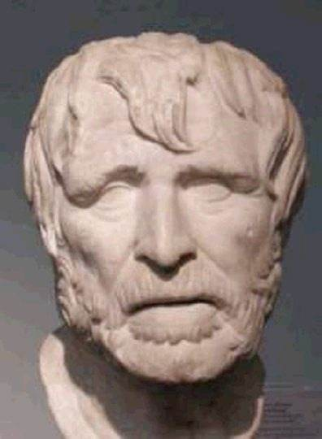
Hesiod and the Theogony
Hesiod, Greek Hesiodos,
Latin Hesiodus, (flourished c. 700 BC), one of the earliest Greek poets, often called the “father of Greek didactic poetry.” Two of his complete epics have survived, the Theogony, relating the myths of the gods, and the Works and Days, describing peasant life.

Slide 25
Not a great deal is known about the details of Hesiod’s life. He was a native of Boeotia, a district of central Greece to which his father had migrated from Cyme in Asia Minor. Hesiod may at first have been a rhapsodist (a professional reciter of poetry), learning the technique and vocabulary of the epic by memorizing and reciting heroic songs. He himself attributes his poetic gifts to the Muses, who appeared to him while he was tending his sheep; giving him a poet’s staff and endowing him with a poet’s voice, they bade him “sing of the race of the blessed gods immortal.” That his epics won renown during his lifetime is shown by his participation in the contest of songs at the funeral games of Amphidamas at Chalcis on the island of Euboea. This, he says, was the only occasion on which he crossed the sea, but it is not likely to have been the only invitation he received from places other than his hometown of Ascra, near Mount Helicon.

Slide 26
the Theogony （《神谱》）
Of Hesiod’s two extant epics, the Theogony is clearly the earlier. In it, following the Muses’ instructions, Hesiod recounts the history of the gods, beginning with the emergence of Chaos, Gaea (Earth), and Eros. Gaea gives birth to Uranus (Heaven), the Mountains, and Pontus (the Sea); and later, after uniting herself to Uranus, she bears many other deities. One of them is the Titan Cronus, who rebels against Uranus, emasculates him, and afterward rules until he in turn is overpowered by Zeus. This story of crime and revolt, which is the central subject of the Theogony, is interrupted by many additional pedigrees of gods. Elsewhere, in addition to mythical family relations, Hesiod presents new ones that are the product of his own speculation. Thus, the names of the 50 sea maidens (the Nereids) fathered by the sea god Nereus indicate various qualities of the Sea. In a different way, the story describing the first woman, Pandora, sent by Zeus to bedevil man, brings out Hesiod’s firm belief in the supreme and irresistible power of Zeus. This power is most majestically displayed in the Titanomachia, the battle between the Olympian gods, led by Zeus, and the Titans, who support Cronus.

Slide 27
Hesiod’s authorship of the Theogony has been questioned but is no longer doubted, though the work does include sections inserted by later poets and rhapsodists. The story of Typhoeus’ rebellion against Zeus was almost certainly added by someone else, while the somewhat overlapping accounts of Tartarus, the hymn on Hecate, and the progeny of the sea monster Keto are highly suspect. The discovery of a Hurrian theogony similar to Hesiod’s seems to indicate that Hesiod’s theogony owes significant episodes to Middle Eastern models. Nonetheless, the Uranus-Cronus-Zeus succession as told by Hesiod approximates the pattern of a classical Greek tragic trilogy. Thus, the Erinyes (the deities of vengeance) are born when Uranus is overthrown by Cronus, while their own hour for action comes when Cronus is about to be overthrown by Zeus. These and other similar features plausibly represent Hesiod’s own contributions to the inherited story.

Slide 28
The Work and Days（《工作与时日》）
Hesiod’s other epic poem, the Works and Days, has a more personal character. It is addressed to his brother Perses, who by guile and bribery has already secured for himself an excessive share of their inheritance and is seeking to gain another advantage in a similar manner. Trying to dissuade him from such practices, Hesiod recounts in the first part of the poem two myths illustrating the necessity for honest, hard work in man’s wretched life. One continues the story of Pandora, who out of curiosity opens a jar, loosing multifarious evils on humanity; the other traces man’s decline since the Golden Age. Against the brutality and injustice of his contemporaries, Hesiod affirms his unshakable belief in the power of justice. For him, Justice is a deity and, indeed, Zeus’s favourite daughter, and the happiness of individuals as well as of communities depends on their treatment of her.

Slide 29
The part of Hesiod’s message that exalts justice and deprecates hubris is addressed to the leaders of his community, who seem inclined to abet Perses. Hesiod also speaks to Perses directly, urging him to abandon his schemes and thenceforth to gain his livelihood through strenuous and persistent work: “Before success the immortal gods have placed the sweat of our brows.” Hard work is for Hesiod the only way to prosperity and distinction. The concept of life that Hesiod here develops is in conscious opposition to the more glorious ideals of the heroic epic of Homer.

Slide 30
In the second half of the poem, Hesiod describes with much practical detail the kind of work appropriate to each part of the calendar and explains how to set about it. The description of the rural year is enlivened by a vivid feeling for the rhythm of human life and the forces of nature, from the overpowering winter storm, which drives man back into his home, to the parching heat of summer, during which he must have respite from his labours.
The poem ends with a series of primitive taboos and superstitions, followed by a section explaining which parts of the month are auspicious for sowing, threshing, shearing, and the begetting of children. It is difficult to believe that either of these sections could have been composed by Hesiod.

Slide 31
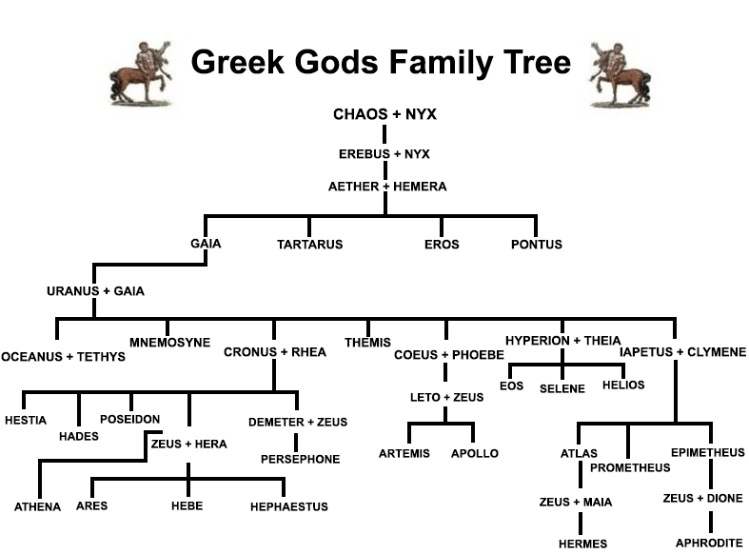

Slide 32
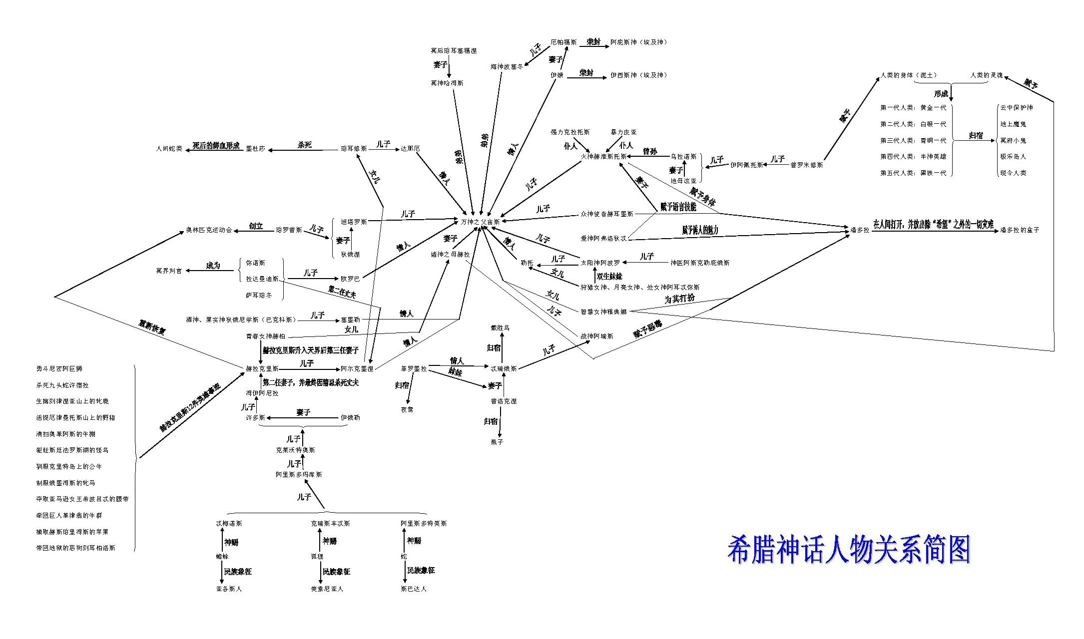

Slide 33
The Text
Muses of Helicon, let us begin our song with them,who hold the great and holy mountain of Helicon,and around its violet-like spring and altar of exceedingly strong Kronios, dance on dainty feet, and who, after bathing their soft skin in the Permessos or the spring of the Horse or holy Olmeios on the peak of Helicon, form their dances, beautiful dances that arouse desire, and they move erotically.
让我们从赫利孔的缪斯开始歌唱吧，她们是这圣⼭的主⼈。她们轻步漫舞，或在碧蓝的泉⽔或围绕着克洛诺斯之⼦、全能宙斯的 圣坛。她们在珀美索斯河、马泉或俄尔斯泉沐浴过娇柔的⽟体后，在⾄⾼的赫利孔⼭上跳起优美可爱的舞蹈，舞步充满活⼒。

Slide 34
From Helicon they rise up veiled in a deep mist and walkthrough the night, sending forth their voice most beautiful, hymning aegis-bearing Zeus and Lady Hera the Argive clad in sandals of gold, and the daughter of Zeus of the aegis, gray-eyed Athena, and Phoebus Apollo and Artemis, who pour forth arrows,
她们夜 间从这⾥出来，⾝披浓雾，⽤动听的歌声吟唱，赞美宙斯——神盾持有者，赞美威严的赫拉——亚哥斯的脚穿⾦鞋⼥神，以及神盾 持有者宙斯的⼥⼉明眸的雅典娜，还有福玻斯。

Slide 35
and Poseidon, holder and shaker of Gaia, and august Themis and Aphrodite of the glancing eyes and Hebe with her golden crown and beautiful Dione, and Leto and Iapetos and Kronos of crooked counsel and Eos and great Helios and shining Selene and Gaia and great Okeanos, and black Night and the sacred clan of the other deathless ones who are for always.
阿波罗、喜爱射箭的阿尔忒密斯、⼤地的浮载者和摇撼者波塞顿、可敬的忒弥斯、眼 波撩⼈的阿佛洛狄特、⾦冠的赫柏、漂亮的狄俄涅、勒托、伊阿佩托斯和狡猾的克洛诺斯、厄俄斯、伟⼤的赫利俄斯和明亮的塞勒涅 ，她们也歌颂该亚、伟⼤的俄刻阿诺斯、⿊暗的纽克斯，以及其它永⽣不朽的神灵。

Slide 36
The Muses once taught Hesiod beautiful song while he was shepherding sheep at the foot of holy Helicon. The goddesses first spoke this word to me，the Muses of Olympus, daughters of aegis-bearing Zeus.“Rustic shepherds, worthless reproaches, mere stomachs,we know how to say many lies like the truth,and, whenever we wish, we know how to tell the truth.”
曾经有⼀天，当赫西俄德正在神圣的赫利孔⼭下 放牧⽺群时，缪斯教给他⼀⽀光荣的歌。也正是这些神⼥枣神盾持有者宙斯之⼥，奥林波斯的缪斯，曾对我说出如下的话，我是听到 这话的第⼀⼈： “荒野⾥的牧⼈，只知吃喝不知羞耻的家伙，我们知道如何把许多虚构的故事说得象真的，但是如果我们愿意，我们也知道如何 述说真事。”

Slide 37
Thus spoke the fluent daughters of mighty Zeus, and they gave me a scepter, a branch of flourishing laurel that they had plucked, a thing of wonder. They breathed in me an inspired voice so I might celebrate what will be and what has been, and they bid me to hymn the clan of the blessed ones who always are and to sing of them first and last.
伟⼤宙斯的能⾔善辩的⼥⼉们说完这话，便从⼀棵粗壮的橄榄树上摘给我⼀根奇妙的树枝，并把⼀种神圣的声⾳吹进我的⼼扉， 让我歌唱将来和过去的事情。她们吩咐我歌颂永⽣快乐的诸神的种族，但是总要在开头和收尾时歌唱她们——缪斯⾃⼰。

Slide 38
You, let us begin from the Muses who in hymning their father Zeus, delight his mighty mind within Olympus, saying what is and what will be and what has been, with voices in tune, and a sound flows tirelessly and sweet from their mouths. The halls of father Zeus loud-thundering laugh as their delicate sound fragments,
来吧，让我们从缪斯开始。她们⽤歌唱齐声述说现在、将来及过去的事情，使她们住在奥林波斯的⽗神宙斯的伟⼤⼼灵感到⾼兴 。从她们的嘴唇流出甜美的歌声，令⼈百听不厌;她们纯洁的歌声传出来，其⽗雷神宙斯的殿堂也听得⾼兴，⽩雪皑皑的奥林波斯⼭ 峰、永⽣神灵的厅堂都缭绕着回⾳。

Slide 39
and the peaks of snow-covered Olympus resound as dothe halls of the immortals. They emit their immortal tones and first celebrate the august clan of the gods in song from the beginning, whom Gaia and wide Ouranos bore, and those born from them, gods, givers of good things. Secondly, they celebrate Zeus, father of gods and men,[corrupt line: The goddesses hymn beginning and ending song]so much is he the foremost of the gods and greatest in power. Again, by hymning the clan of men and powerful Giants, they delight the mind of Zeus within Olympus.
她们⽤不朽的歌声从头唱起，⾸先赞颂可敬的神的种族——⼤地和⼴天结合⽣下的那些神灵—— ⼀切有⽤之物的赐予者，其次在歌曲开始和结束时，歌唱诸神和⼈类之⽗宙斯，称赞他是神灵中最卓越者、最强有⼒。此外，她们还 歌颂⼈类和巨⼈，在奥林波斯取悦宙斯的⼼灵——

Slide 40
Muses of Olympus, daughters of aegis-bearing Zeus, whom Mnemosyne mingled with father Kronios1 and bore in Pieria, while she was guarding the fields of Eleutheros to be forgetfulness of troubles and cessation of worries. For nine nights, the counselor Zeus was mingling with her apart from the immortals, going up into her sacred bed. But when it had been a year, and the seasons of the withering months turned, and the many days were fulfilled, she bore nine maidens, alike in mind, who care for song in their breasts and whose spirits are free of pain, down a little from the highest peak of snow covered Olympus.
她们是奥林波斯的缪斯，神盾持有者宙斯的⼥⼉们。 统治厄琉塞尔⼭丘的记忆⼥神谟涅摩绪涅在⽪埃⾥亚⽣了她们，她和克洛诺斯之⼦宙斯结合⽣下她们——没病没痛⽆忧⽆虑的九 个神⼥。英明的宙斯和她同寝九夜，远离众神睡在她那圣床上。随着⼀个⽉⼀个⽉的流逝，同样的季节⼜回来了，⼀年过去了，她⽣下九个⼥⼉。（她们有⼀样的思想，都爱好歌曲，她们的⼼灵⼀样地⽆忧⽆虑。）她们就⽣在离冰雪覆盖的奥林波斯⼭最⾼峰很近的 地⽅，

Slide 41
There are their shining dancing places and beautiful halls, and beside them the Graces and Desire have their dwellings amid festivities. Sending forth their lovely voice they sing songs and celebrate the ordinances and trusty ways of all the immortals, sending forth their lovely voice.
Then they go to Olympus, glorying in their beautiful voice amid ambrosial song. All around them as they hymn, black Gaia laughs, and a lovely din rises up from their feet as they are coming to their father. He is king in Ouranos, holding the thunder and gleaming lightning bolt and after conquering his father Kronos by power.
那⾥有她们明亮的舞蹈场地、漂亮的住处，美惠神⼥和愿望之神愉快地与之为邻。她们⼝吐优美歌声，⽤歌声赞美万物的法则 和不朽众神的美好⽣活⽅式;然后，她们满意⾃⼰有⼀副甜美的歌喉，唱着神圣的歌曲⾛上奥林波斯⼭巅。她们吟唱时，⿊暗的⼤地 在她们⾝边发出回⾳;她们去见⽗神时，美妙的歌声从她们脚下升起。宙斯⽤武⼒推翻了⾃⼰的⽗亲克洛诺斯后，那时正统治着天宇 。

Slide 42
Fairly in each did he distribute to the immortals their ordinances and devise their provinces. These things the Muses who have their hall on Olympus, sing, the nine daughters sired by mighty Zeus, Kleio and Euterpe and Thaleia and Melpomene and Terpsichore and Erato and Polymnia and Ourania and Kalliope. The last is the foremost of them all, for she accompanies and attends revered kings Whomever the daughters of mighty Zeus honor and see being born from kings nurtured by Zeus, upon his tongue they pour dew sweeter than honey and from his mouth flow soothing words…
她⾃⼰拥有闪电和霹雳，公平地给众神分配了财富，宣布了荣誉。 因此，住在奥林波斯⼭上的缪斯——伟⼤宙斯的九个⼥⼉歌颂这⼀切。她们的名字是：克利俄、欧忒⽿佩、塔利亚、墨尔波墨涅 、忒⽿普霍瑞、厄拉托、波吕姆尼亚、乌剌尼亚、卡利俄佩。卡利俄佩是她们⼤家的⾸领，她总是是陪伴着爱⼈尊敬的巴西琉斯。伟 ⼤宙斯的⼥⼉尊重宙斯抚育下成长的任何⼀位巴西琉斯，看着他们出⽣，让他们吮吸⽢露，赐予他们优美的⾔词……

Slide 43
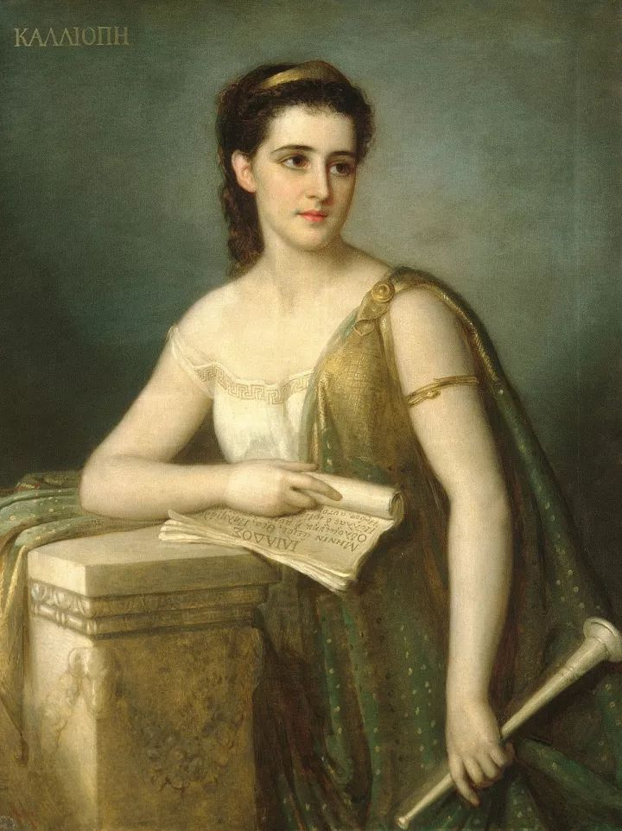
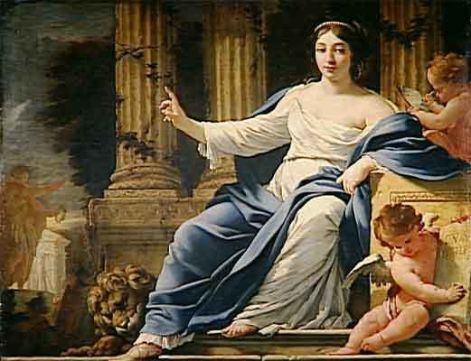
卡利俄珀（Calliope）与波吕许谟尼亚（Polyhymnia） 史诗女神 颂歌女神

Slide 44
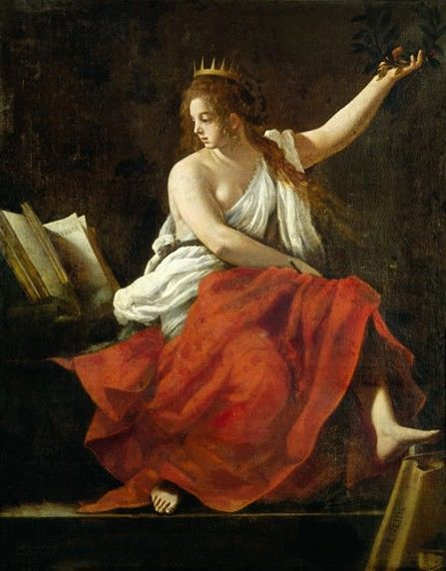
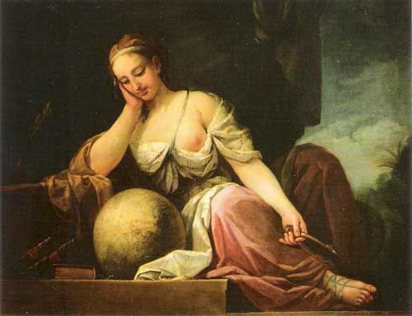
克利俄（Clio）与乌拉尼亚（Urania） 历史女神 天文女神

Slide 45
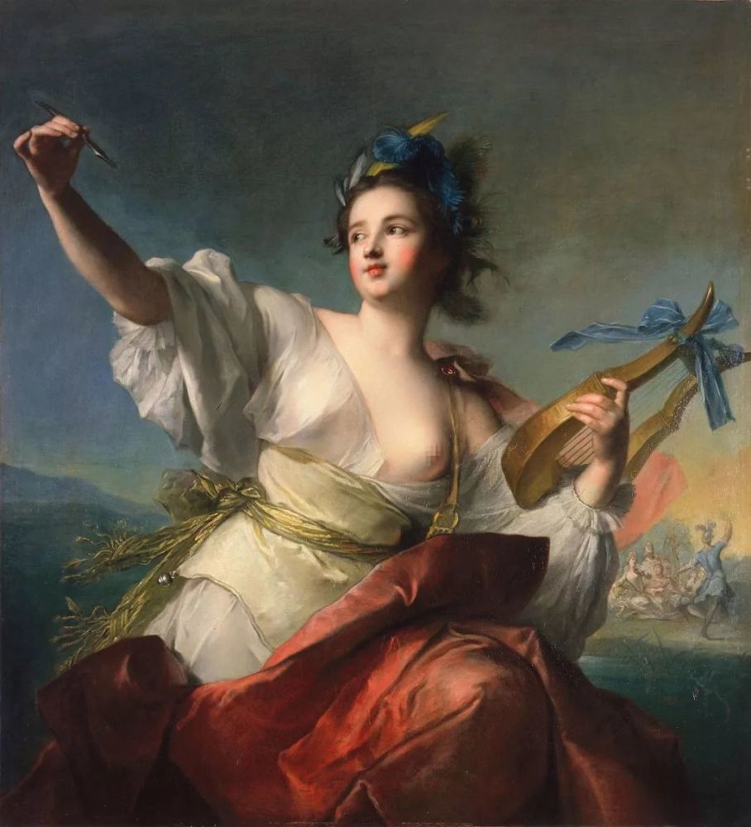
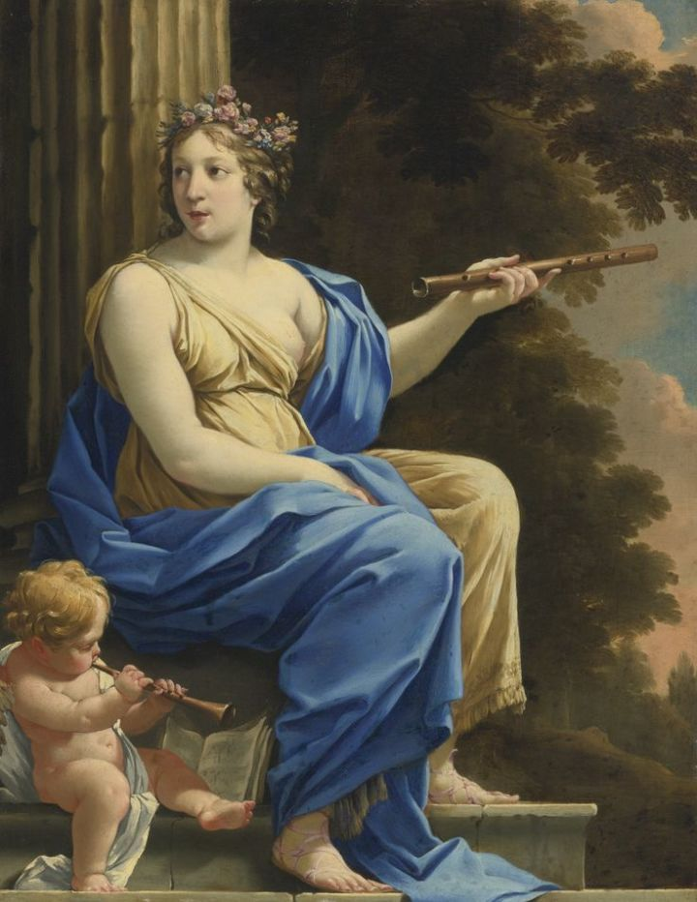
特耳西科瑞（Terpsichore）与欧忒耳佩（Euterpe） 合唱与舞蹈女神 音乐女神

Slide 46
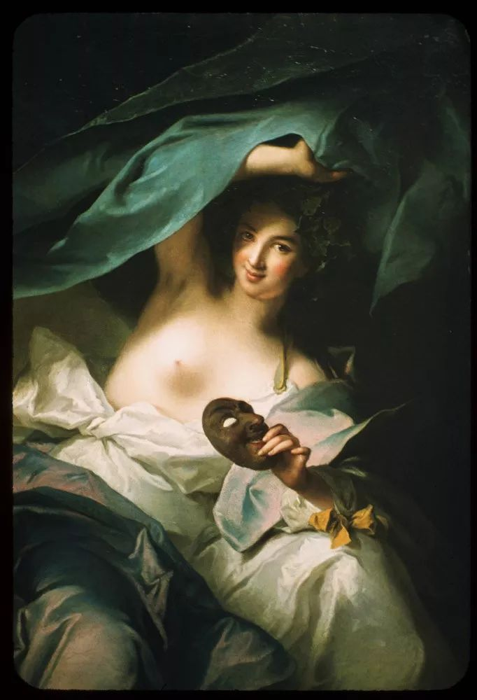
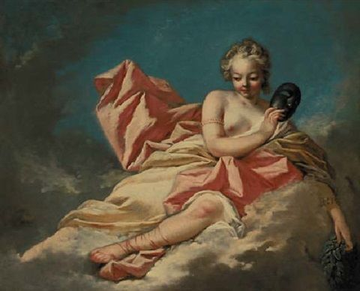
墨尔波墨涅（Melpomene） 与塔利亚（Thalia） 悲剧女神 喜剧女神

Slide 47
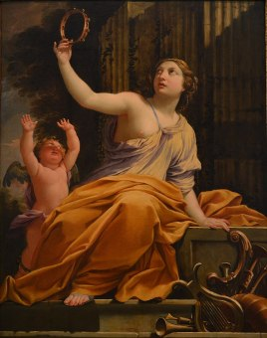
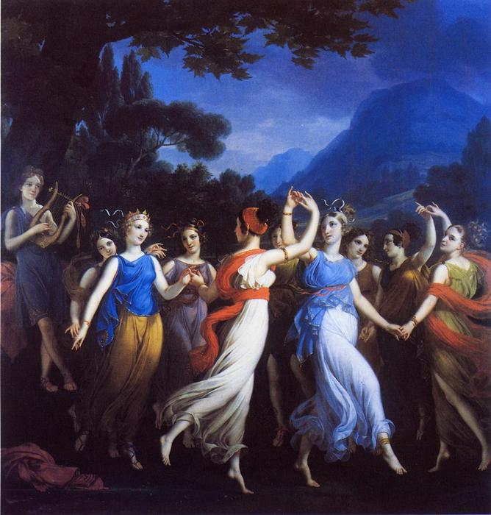
埃拉托（Erato）抒情诗女神

Slide 48
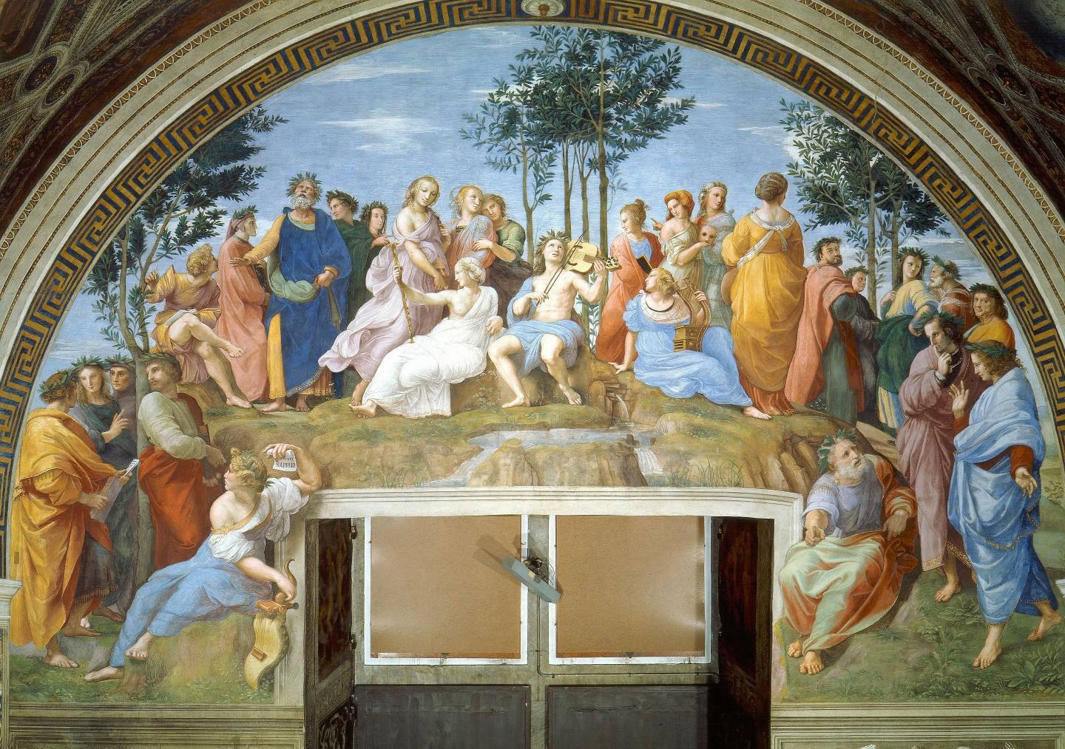
Parnassus

Slide 49
九位缪斯：西方传统中的诗歌之神，几乎所有古代诗人在写诗的开始都要向她们祷告祈求灵感
《伊利亚特》开篇：“歌唱吧，女神[缪斯]！歌唱裴琉斯之子阿基琉斯的愤怒，他的暴怒招致了这场凶险的灾祸，给阿开亚人带来了受之不尽的苦难……”
《奥德赛》开篇：告诉我，缪斯，那位聪颖敏睿的凡人的经历，在攻破神圣的特洛伊城堡后，浪迹四方。他见过许多种族的城国，领略了他们的见识，心忍着许多痛苦，挣扎在浩森的大洋，为了保住自己的性命，使伙伴们得以还乡。但即便如此，他却救不下那些朋伴，虽然尽了力量：他们死于自己的愚莽，他们的肆狂，这帮笨蛋，居然吞食赫利俄斯的牧牛，被日神夺走了还家的时光。开始吧，女神，宙斯的女儿，请你随便从哪里开讲。
维吉尔《牧歌》IV：“西西里的缪斯啊，让我们唱些更崇高的歌……”

Slide 50
First of all Chaos [Gap] came into being. But then Gaia broad-chested, always the unshakable seat of all the immortals who hold the peaks of snowy Olympus, and dark Tartaros in the recesses of the wide-wayed earth, and Eros, the most beautiful among the immortal gods, loosener of limbs, who subdues the mind and prudent counsel in the chests of all gods and of all men.
最⽣产⽣的确实是卡俄期（混沌），其次便产⽣该亚——宽胸的⼤地，所有[⼀切以冰雪覆盖的奥林波斯⼭峰为家的神灵]的永远 牢靠的根基，以及住在道路宽阔的⼤地深处的幽暗的塔⽿塔罗斯、爱神厄罗斯——在不朽的诸神中数她最美，能使所有的神和所有的 ⼈销魂荡魄呆若⽊鸡，使他们丧失理智，⼼⾥没了主意。

Slide 51
From Chaos were born Erebos and black Night. From Night, again, were born Aether and Day, whom she conceived and bore after mingling with Erebos in philotês. Gaia first bore equal to herself starry Ouranos so that he may cover her all over like a veil, to be always the unshakable seat for the blessed gods.
从混沌还产⽣出厄瑞玻斯和⿊⾊的夜神纽克斯;由⿊夜⽣出埃忒⽿和⽩天之 神赫莫拉，纽克斯和厄瑞玻斯相爱怀孕⽣了他俩。⼤地该亚⾸先⽣了乌兰诺斯——繁星似锦的皇天，他与她⼤⼩⼀样，覆盖着她，周 加衔接。⼤地成了快乐神灵永远稳固的逗留场所。

Slide 52
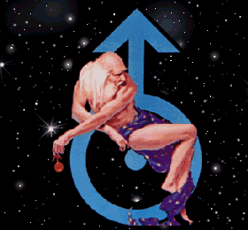
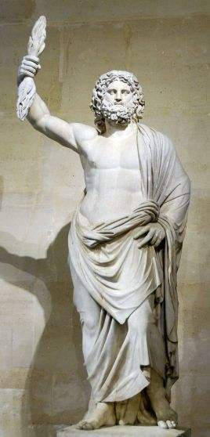
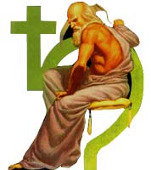
Ouranos, Kronos and Zeus

Slide 53

The Sky and the earth Ouranus and Gaia

Slide 54
Gaea, also called Ge, Greek personification of the Earth as a goddess. Mother and wife of Uranus (Heaven), from whom the Titan Cronus, her last-born child by him, separated her, she was also mother of the other Titans, the Gigantes, the Erinyes, and the Cyclopes (see giant; Furies; Cyclops). Gaea may have been originally a mother goddess worshipped in Greece before the Hellenes introduced the cult of Zeus. Less widely worshipped in historic times, Gaea was described as the giver of dreams and the nourisher of plants and young children. Gaea is often shown as being present at the birth of Zeus, but in some legends she is his enemy because she is the mother of the giants and of the 100-headed monster Typhon.

Slide 55
She bore the large mountains, pleasant haunts of the goddess Nymphs who dwell up along the woody mountains, and he produced the unplowed (?) open waters raging with swell, Pontos, without philotês. But then bedded by Ouranos, she produced deep-eddying Okeanos and Koios and Kreios and Hyperion and Iapetos and Thea and Rheia and Themis and Mnemosyne and golden-garlanded Phoebe and lovely Tethys. And after them born last Kronos of the crooked scheme, most fearful of children, and he hated his lusty father.
⼤地还⽣了绵延起伏的⼭脉和⾝居⼭⾕的⾃然神⼥纽墨菲的优雅住处。⼤地未经甜 蜜相爱还⽣了波涛汹涌、不产果实的深海蓬托斯。后来⼤地和⼴天交合，⽣了涡流深深的俄刻阿诺斯、科俄斯、克利俄斯、许佩⾥翁 、伊阿佩托斯、忒亚、瑞亚、忒弥斯、谟涅摩绪涅以及⾦冠福柏和可爱的忒修斯。他们之后，狡猾多计的克洛诺斯降⽣，他是⼤地 该亚所有⼦⼥中最⼩但最可怕的⼀个，他憎恨他那性欲旺盛的⽗亲。

Slide 56
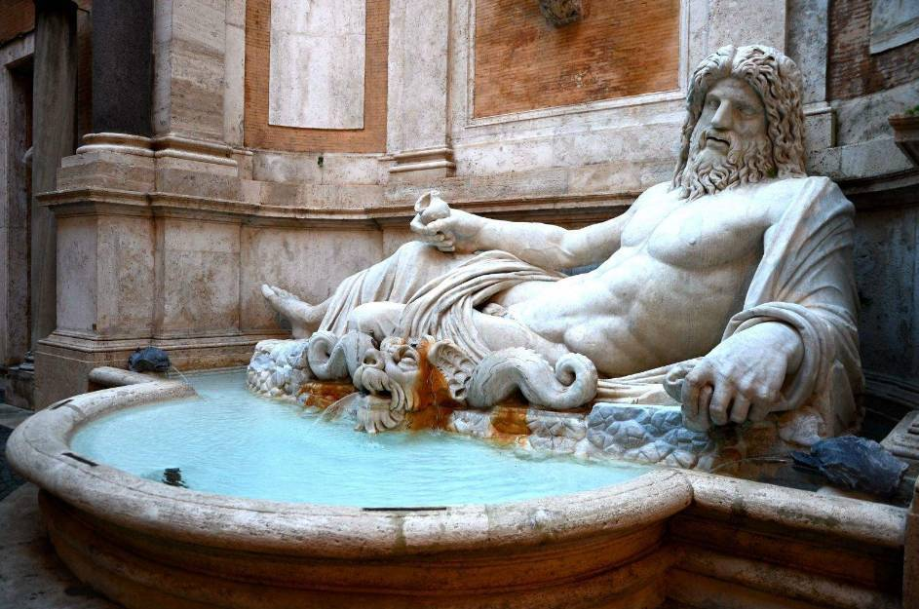
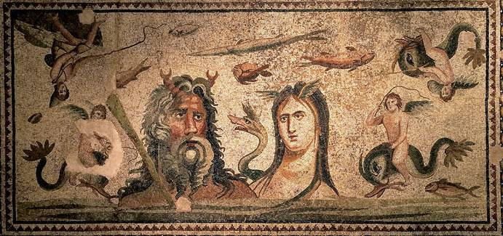
Oceanus
Oceanus, in Greek mythology, the river that flowed around the Earth (conceived as flat), for example, in the shield of Achilles described in Homer’s Iliad, Book XVIII. Beyond it, to the west, were the sunless land of the Cimmerii, the country of dreams, and the entrance to the underworld. In Hesiod’sTheogony, Oceanus was the oldest Titan, the son of Uranus (Heaven) and Gaea (Earth), the husband of the Titan Tethys, and father of 3,000 stream spirits and 3,000 ocean nymphs.

Slide 57
The Cyclopes
She further bore the Kyklopes with exceeding forceful hearts, Brontes and Steropes and Arges mighty of spirit, who gave to Zeus the thunder sound and fashioned the thunderbolt. They were like the gods in all respects except the single eye that lay in the middle of their foreheads. They are named Kyklopes from this feature, because one circular eye lay in the forehead of each. Strong is their brute force, and designs are upon their deeds.
⼤地还⽣了勇敢⽆⽐的库克洛佩斯——赠给宙斯雷电、为宙斯制造霹雳的布戎忒斯、斯忒罗佩斯和⽆⽐勇敢的阿⽿⼽斯。他们都 只有⼀只眼睛，长在前额中间，除此⽽外，⼀切⽅⾯都象神。由于他们都仅有⼀只圆眼长在额头上，故⼜都号称库克洛佩斯。他们强 壮有⼒、⼿艺精巧。

Slide 58
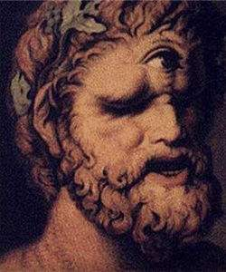
Cyclops, (Greek: “Round Eye”) in Greek legend and literature, any of several one-eyed giants to whom were ascribed a variety of histories and deeds. In Hesiod the Cyclopes were three sons of Uranus and Gaea—Arges, Brontes, and Steropes (Bright, Thunderer, Lightener)—who forged the thunderbolts of Zeus. Later authors made them the workmen of Hephaestus and said that Apollo killed them for making the thunderbolt that slew his son Asclepius.

Slide 59
Others were born from Gaia and Ouranos, three great and mighty children not to be named, Kottos and Briareos and Gyges, exceedingly arrogant children. A hundred arms shot forth from their shoulders, not to be molded into an image, and on each fifty heads grew upon the fifty shoulders on sturdy limbs. Strong, immense, powerful in their shape.
该亚和乌兰诺斯还⽣有另外三个魁伟、强劲得⽆法形容的⼉⼦，他们是科托斯、布⾥阿瑞俄斯和古埃斯——三个⽬空⼀切的孩⼦ 。他们户膀上长出⼀百只⽆法战胜的臂膀，每⼈的户上和强壮的肢体上都还长有五⼗个脑袋。他们⾝材魁伟、⼒⼤⽆穷、不可征服。

Slide 60
So many were born of Gaia and Ouranos, most dreadful of children, and they hated their father from the beginning. As soon as one of them was born, Ouranos would conceal them all in hiding place in Gaia and did not sent them back into the light, and he delighted in his evil deed. Monstrous Gaia was groaning within, congested. She conceived a cunning, evil trick. Quickly she made the element of grey adamant and fashioned a great sickle and showed it to her children. Then she spoke, encouraging them, though sorrowing in her heart.
在天神和地神⽣的所有⼦⼥中，这些⼈最可怕，他们⼀开始就受到⽗亲的憎恨，刚⼀落地就被其⽗藏到⼤地的⼀个隐秘处，不能见到 阳光。天神⼗分欣赏⾃⼰的这种罪恶⾏为。但是，⼴阔的⼤地因受挤受窄⽽内⼼悲痛，于是想出⼀个巧妙但罪恶的计划。她即刻创造 了⼀种灰⾊燧⽯，⽤它做成⼀把巨⼤的镰⼑，并把⾃⼰的计谋告诉给亲爱的⼉⼦们。她虽然内⼼悲伤，但还是⿎动他们，说道：

Slide 61
“My children with a reckless father, if only you agree to obey me. We would avenge the evil outrage of this father of yours, for he first devised unseemly deeds.”Thus she spoke, and binding fear grabbed them all, and none of them spoke. Then great Kronos of crooked counsel, embolden, quickly addressed his dear mother with words:“Mother, I promise that I will bring to completion, this deed, since I do not care for that ill-named father of ours. For he first devised unseemly deeds.”
“我的孩⼦，你们有⼀位罪恶的⽗亲，如果你们愿意听我的话，让我们去惩罚你们⽗亲的⽆耻行径吧!是他最先想出作起⽆耻之事的。” 她说了这番话之后，孩⼦们全被恐惧所⽀配，⽆⼈敢于开⼝。但狡猾强⼤的克洛诺斯⿎起勇⽓回答了亲爱的母亲：“妈妈，我答应你做这个事情，因为我看不起臭名昭著的⽗亲，是他最先做出⽆耻之事的。”

Slide 62
Thus he spoke, and monstrous Gaia laughed loudly in her heart. She hid him in an ambush and placed in his hands a serrated sickle, and apprised him of her whole cunning. Great Ouranos came, bringing the night, and spread out around Gaia, desiring philotês, and was extended. His son reached out from ambush with his left hand, and in his right he held the sickle, long and serrated and the genitals of his father he quickly reaped and threw them behind his back to be carried away. But they did not flee from his hand fruitlessly. As many drops of blood spurted forth, all of them Gaia received.
听了克洛诺斯这样的回答，地神该亚欣喜万分，安排他埋伏在⼀个地⽅，交给他⼀把缺⼝如锯齿的镰⼑，并向他和盘托出了整个 计划。 ⼴⼤的天神乌兰诺斯来了，带来了夜幕，他渴求爱情，拥抱⼤地该亚，展开肢体整个地覆盖了⼤地。此时，克洛诺斯从埋伏处伸 出左⼿，右⼿握着那把有锯齿的⼤镰⼑，飞快地割下了⽗亲的⽣殖器，把它往⾝后⼀丢，让它掉在他的后⾯。它也没⽩⽩地从他⼿⾥ 丢掉，由它溅出的⾎滴⼊⼤地，

Slide 63
In the revolving years, she bore the powerful Erinyes, and great Giants, gleaming in their armor, holding long spears in their hands, and the nymphs whom they call the Ash Tree Nymphs across endless Gaia. As soon as Kronos lopped off the genitals with the sickle, they fell from the mainland into the much-surging sea, so that the sea carried them for a long time. Around them a white foam from the immortal skin began to arise. In it, a maiden was nurtured. First, she drew near holy Kythera, and from there she arrived at Kypros surrounded by water. From within, a majestic and beautiful goddess stepped, and all around grass grew beneath her slender feet.
随着季节的更替，⼤地⽣出了强壮的厄⾥倪厄斯和穿戴闪光盔甲、⼿执长⽭、⾝材⾼⼤的癸⼲忒斯， 以及整个⽆垠⼤地上被称作墨利亚的⾃然神⼥们。克洛诺斯⽤燧⽯镰⼑割下其⽗的⽣殖器，把它扔进翻腾的⼤海后，这东西在海上飘 流了很长⼀段时间，忽然⼀簇⽩⾊的浪花从这不朽的⾁块周围扩展开去，浪花中诞⽣了⼀位少⼥。起初，她向神圣的库忒拉靠近;尔 后，她从那⼉来到四⾯环海的塞浦路斯。在塞浦路斯，她成了⼀位庄重可爱的⼥神，在她娇美的脚下绿草成茵。

Slide 64
Aphrodite foam-born goddess and fair-wreathed Kythereia] gods and men call her because she was nurtured in foam. But they call her Kythereia because she happened upon Kythera, and Kyprogenes because she was born in much-surging Kypros, and Philommeides because she appeared out of genitals. Eros was her constant companion, and beautiful Desire followed her when she was being born and when she was entering the throng of the gods. From the beginning she held sway and obtained this province among men and immortal gods: a young girl's whispers and smiles and deceits and sweet delight and philotês and graciousness.
由于她是在浪花[“ 阿佛洛斯”]中诞⽣的，故诸神和⼈类都称她阿佛洛狄特[即“浪花所⽣的⼥神”或“库忒拉的华冠⼥神”]；由于到过库忒拉，因此 也称“库忒瑞亚”；⼜因为出⽣在波涛滚滚的塞浦路斯，故⼜称塞浦洛格尼亚；⼜因为是从男性⽣殖器产⽣的，故⼜名“爱阴茎的” 。⽆论在最初出⽣时还是在进⼊诸神⾏列后，她都有爱情厄罗和美貌的愿望⼥神与之为伴。她⼀降⽣便获得了这⼀荣誉。她也在神和 ⼈中间分得了⼀份财富，即少⼥的窃窃私语和满⾯笑容，以及伴有甜蜜、爱情和优雅的欺骗。

Slide 65
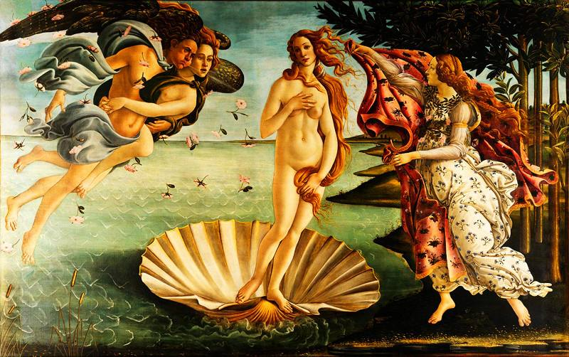
The birth of Aphrodite

Slide 66
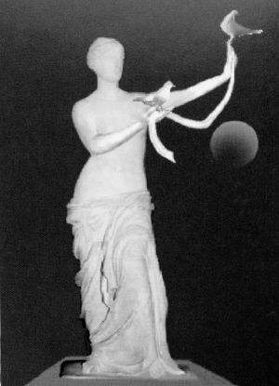
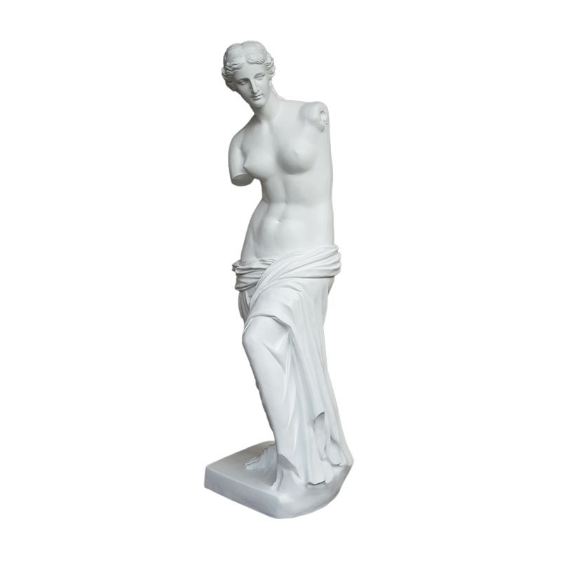
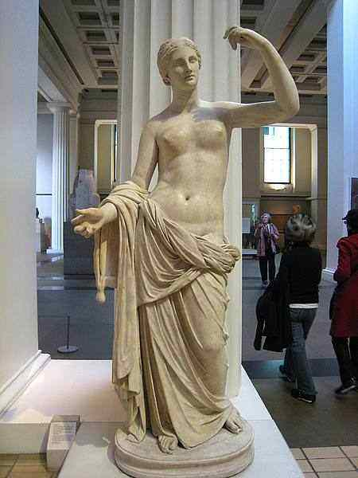
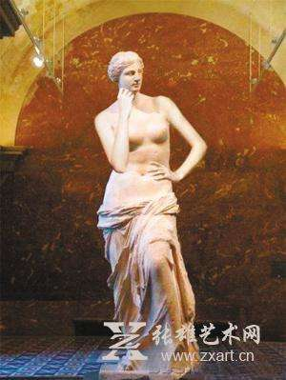
The Arms of Aphrodite

Slide 67
Father great Ouranos, quarreling with the children he sired himself, gave them the name Titans, Stretchers. He said that they stretched with a great recklessness to accomplish a huge deed, and for it retribution shall be laid up for the future Night bore hateful Death Appointed and black Doom and Death, and she bore Sleep and the tribe of Dreams. Then dark Night bore Blame and painful Woe, not lying with any of the gods, and the Hesperides who live beyond renowned Okeanos and care for the beautiful golden apples and the trees bearing fruit. She gave birth to the Appointers of Death and Goddesses of Doom who punish relentlessly.
伟⼤的乌兰诺斯⽗神在责骂⾃⼰⽣的这些孩⼦时，常常⽤浑名称他们为提坦（紧张者）。他说他们曾在紧张中犯过⼀个可怕的罪 恶，将来要受到报应的。 夜神纽克斯⽣了可恨的厄运之神、⿊⾊的横死之神和死神，她还⽣下了睡神和梦呓神族。尽管没有和谁结婚，⿊暗的夜神还⽣了 诽谤之神、痛苦的悲哀之神和赫斯佩⾥得斯姊妹。赫斯佩⾥得斯看管着光荣⼤洋俄刻阿诺斯彼岩好看的⾦苹果和果实累累的树林。

Slide 68
[She also bore Klotho, Spinner of Life's Thread, and Lachesis, Dispenser of Lots, Atropos, Unturnable One, who give to mortals as they are born what is good and bad to have,]who pursue the transgressions of men and gods, and the goddess never cease from their dreadful wrath until whoever transgresses pays someone back evil punishment. Destructive Night also bore Retribution, a bane for mortal men. Then she bore Deceit and Passion and destructive Old Age and mighty-hearted Strife.
⿊夜还⽣有司常命运和⽆情惩罚的三⼥神——克洛索、拉赫西斯和阿特洛泊斯。这三位⼥神在⼈出⽣时就给了他们善或恶的命运，并且监察神与⼈的⼀切犯罪⾏为。在犯罪者受到惩罚之前，她们决不停⽌可怕的愤怒。可怕的夜神还⽣有折磨凡⼈的涅墨西斯，继之，⽣了欺骗⼥神、友爱⼥神、可恨的年龄⼥神和不饶⼈的不和⼥神。

Slide 69
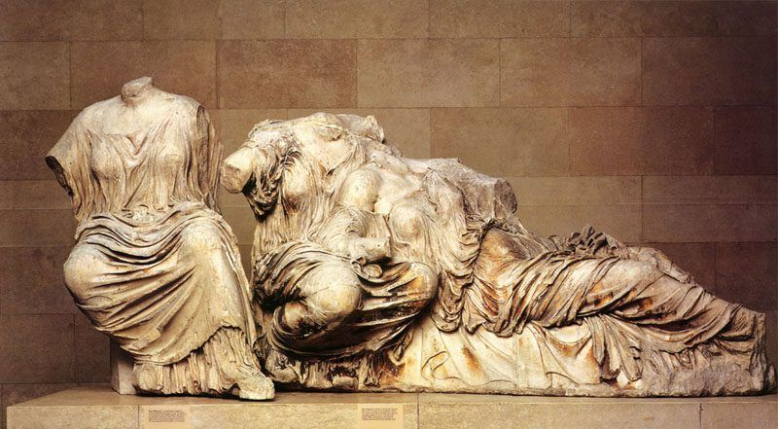

Slide 70
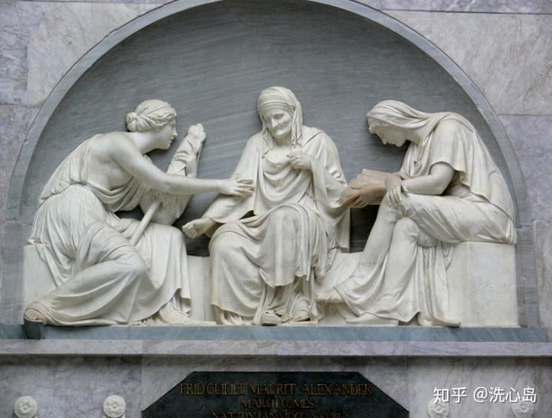
Clotho, Lachesis and Atropos
Clotho spins the thread of life; Lachesis determines the length of the thread of life; Atropos cuts the thread of life.

Slide 71
To Porkys Keto bore fair-cheeked old womengray haired from birth, whom the immortals call the Old Women as do men who walk the earth, andPemphredo of the lovely dress and Enyo of the saffron dress;She bore too the Gorgons who dwell near renowned Okeanosat the borders of the night beside the clear-toned Hesperides, Sthenno, Euryale and Medusa who suffered grievously.
刻托给福⽿库斯⽣下了⾯孔迷⼈的格赖埃姐妹，她们⼀⽣下就头发灰⽩。不死的神灵和⼤地上的⼈类都叫她们格赖埃。好们是⾐ 着华丽的彭菲瑞多和袍⾊桔红的厄倪俄。刻托和福⽿库斯还⽣了⼽⽿⼽。⼽⽿⼽居住在光荣⼤洋俄刻阿诺斯的彼岩——嗓⾳清晰的赫 斯佩⾥得斯姊妹也住在这⾥——与⿊夜之地相接的地⽅。她们是斯忒诺、欧律阿勒和命运悲惨的墨杜萨。

Slide 72
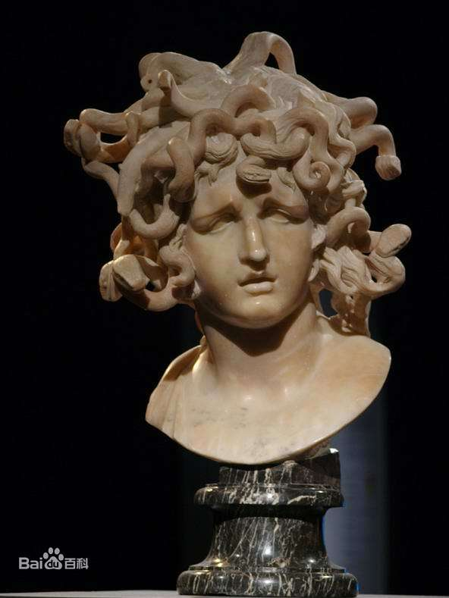
Gorgon, monster figure in Greek mythology. Homer spoke of a single Gorgon—a monster of the underworld. The later Greek poet Hesiod increased the number of Gorgons to three—Stheno (the Mighty), Euryale (the Far Springer), and Medusa (the Queen)—and made them the daughters of the sea god Phorcys and of his sister-wife Ceto. The Attic tradition regarded the Gorgon as a monster produced by Gaea, the personification of Earth, to aid her sons against the gods. In early classical art the Gorgons were portrayed as winged female creatures; their hair consisted of snakes, and they were round-faced, flat-nosed, with tongues lolling.

Slide 73
She was mortal, while they were immortal and ageless,the two. With the one, Medusa, dark-maned Poseidon layin a soft meadow and amid the spring flowers.When Perseus cut her head from her neck,mighty Chrysaor leaped out and the horse Pegasos.The latter had this name because he was born beside the Pagae,
墨杜萨是会死的凡⼈，斯忒 诺和欧律阿勒则常⽣不死。⿊发波塞顿曾和墨杜萨躺在⼀块鲜花盛开的草地上睡觉。珀尔塞斯砍掉她崐的头颅后，从她的躯⼲⾥⽣出 了⾼⼤的克律萨俄⽿和神马佩伽索斯。佩加索斯就是因为出⽣在⼤洋的源头（“佩加”）附近⽽得名的。

Slide 74
Medusa, was usually represented as a winged female creature having a head of hair consisting of snakes; unlike the Gorgons, she was sometimes represented as very beautiful. Medusa was the only Gorgon who was mortal; hence her slayer, Perseus, was able to kill her by cutting off her head. From the blood that spurted from her neck sprang Chrysaor and Pegasus, her two sons by Poseidon.

Slide 75
while the other was born holding a golden sword in his hands. Pegasos, flying upwards, left the earth mother of flocks, reached the immortals. He lives in the halls of Zeus and brings to Zeus the counselor his thunder and flash. Chrysaor bore three-headed Geryones, having mingled with Kallioroe, daughter of renowned Okeanos. The brutal force of Herakles slew him beside the rolling-gaited cows at sea-girt Erytheia on that day when he was driving his broad-headed cattle to sacred Tiryns, having crossed Okeanos' stream…
克律萨俄⽿则是因为他有⼀ 本⾦剑（“克律斯”意为“⾦的”、“阿俄⽿”意为“剑”）⽽得名。现在佩伽索斯飞离了地⾯——畜群之母，来到了不死的神灵中 间。他住在宙斯的宫殿⾥，把霹雳和闪电传送到英明的宙斯⼿⾥。克律萨俄⽿与光荣⼤洋神的⼥⼉卡利罗厄相爱，⽣下了三个脑袋的 巨⼈⾰律翁。⼤⼒的赫拉克勒斯穿过⼤洋的渡⼝，在光荣的俄刻阿诺斯彼岩的昏暗牧场上杀死了俄⽿托斯和牧⼈欧律提翁后，驱直着 宽额的⽜群要去神圣梯林斯的那天，在四⾯环海的厄律提亚把⾰律翁杀死在他懒洋洋的⽜群旁……

Slide 76
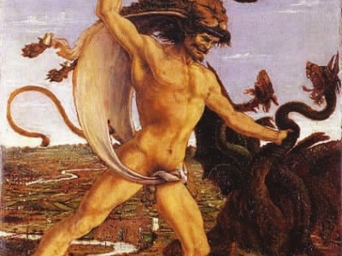
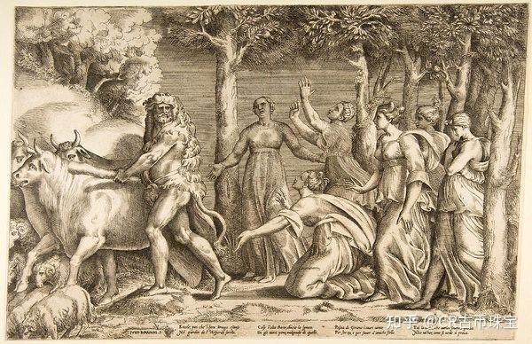
Geryon: a winged monster with three bodies joined at the waist, killed by Hercules, whostole the monster's cattle as his tenth labour

Slide 77
Tethus to Okeanos bore the whirling rivers… and desirable Kalypso and Eudrore and Tyche and Amphiro and Okyroe and Styx, who is the most preeminent of all. These were born of Okeanos and Tethyos, their eldest daughters. Yet, there are many others, for three thousand are the slender-ankled Okeanids, who, spread wide, haunt the Gaia and the waters' depths everywhere alike, the glorious children of goddesses. Again there are as many other rivers roaring loudly, sons of Okeanos, whom Lady Tethys bore. Their names a mortal man would be hard put to tell. Each of them knows those who dwell nearby.
忒修斯给⼤洋神俄刻阿诺斯⽣下了⽔流湍急的诸河之神……迷⼈的卡吕普索、欧多拉、提刻、安菲洛、俄库⽿罗厄，以及她们的⾸领斯梯克斯。她 们是⼤洋神和忒修斯最先出世的⼀批⼥⼉。除此⽽外，⼤洋神和忒修斯还有许多⼥⼉。⼤洋神有三千个美踝的⼥⼉，她们分散在四⾯ ⼋⽅，虽然所居的地⽅不同，但都⼀样地服务于⼤地和海洋。她们都是光荣的神⼥。庄重的忒修斯给⼤洋神还⽣有许多其他的⼉⼦ ——流动时潺潺作声的河流，凡⼈虽不易说出他们的名字，但可以依据他们不同的居地识别他们。

Slide 78
Theia bore mighty Helios and gleaming Selene and Eos who shines for all those on Gaia and for the immortal gods who hold wide Ouranos, having been subdued in Hyperion's philotês .With Kreio, Eurybie mingled in philotês and boremighty Astraios and Pallas and Perses, that one shining among goddesses. Perses surpassed all in skills.
忒亚和许佩⾥翁相爱，⽣下魁伟的赫利俄斯（太阳）、明亮的塞勒涅（⽉亮）和厄俄斯（黎明）。厄俄斯照耀⼤地上的万物和⼴ 阔天宇中的不死神灵。 欧律⽐亚爱上了克利俄斯，他们结合⽣下⾼⼤的阿斯特赖俄斯、帕拉斯和珀⽿塞斯。珀⽿塞斯是⼈类中的智慧超群者。

Slide 79
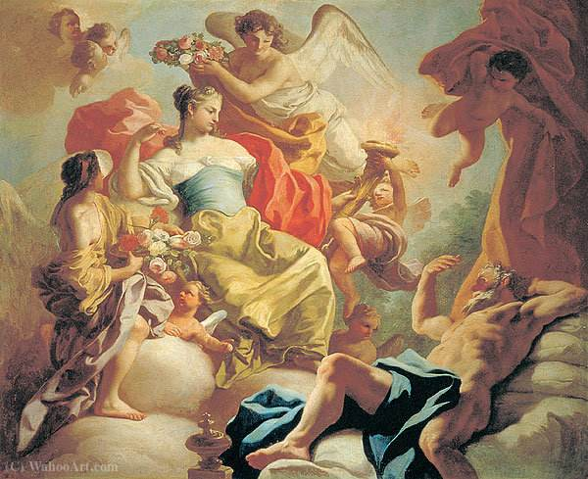
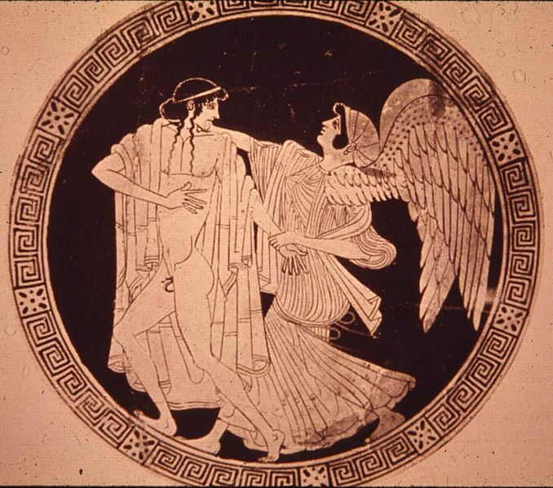
厄俄斯（Eos）and 第索纳斯（Tithonus）
Does eternal life alone means happiness?

Slide 80
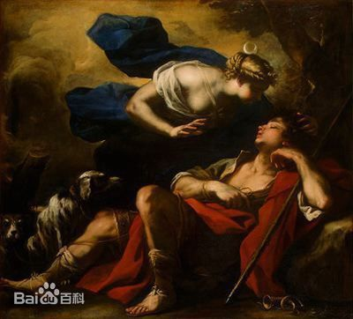
塞勒涅（Selene）and 恩底弥翁（Endymion）

Slide 81
Selene, (Greek: “Moon”) Latin Luna, in Greek and Roman religion, the personification of the moon as a goddess. She was worshipped at the new and full moons. According to Hesiod’s Theogony, her parents were the Titans Hyperion and Theia; her brother was Helios, the sun god(sometimes called her father); her sister was Eos (Dawn). In the Homeric Hymn to Selene, she bears the beautiful Pandeic to Zeus, while Alcman says they are the parents of Herse, the dew. She is often linked with Endymion, whom she loved and whom Zeus cast into eternal sleep in a cave on Mount Latmus; there, Selene visited him and became the mother of 50 daughters. In another story she was loved by Pan. By the 5th century BC Selene was sometimes identified with Artemis, or Phoebe, “the bright one.” She was usually represented as a woman with the moon (often in crescent form) on her head and driving a two-horse chariot. As Luna, she had temples at Rome on the Aventine and Palatine hills.

Slide 82
Endymion by John Keats
A thing of beauty is a joy
for ever: Its loveliness increases; it will never Pass into nothingness; but still will keep A bower quiet for us, and a sleep Full of sweet dreams, and health, and quiet
breathing...
凡美的事物就是永恒的喜悦: 它的美与日俱增:它永不湮灭, 它永不消亡;它永远 为我们保留着一处幽亭,让我们安眠, 充满了美梦、健康和宁静的呼吸…

Slide 83
…Some shape of beauty
moves away the pall From our dark spirits. Such the sun, the moon, Trees old and young, sprouting a shady boon For simple sheep; and such are daffodils With the green world they live in; and clear rills That for themselves a cooling covert make ’Gainst the hot season; the
mid-forest brake,
…某种形式的美总会揭去 笼罩在我们心灵上的黑幕。看那太阳、月亮, 还有为天真的羊群 长出遮荫凉棚的古木幼树;又如水仙 和它们生活其间的绿茵世界;还有清溪 为自己造好凉荫

Slide 84
Rich with a sprinkling of fair musk-rose blooms: And such too is the grandeur of the dooms We have imagined for the mighty dead; All lovely tales that we
have heard or read: An endless fountain of
immortal drink, Pouring unto us from the heaven’s brink.
以御炎季;林中灌木, 满洒着麝香蔷薇小花: 还有我们想象伟大的古人 其命运的壮丽; 我们所听到或读到的一切美妙的故事: 这都构成无尽的不朽仙泉, 从天际注入我们的心田。

Slide 85
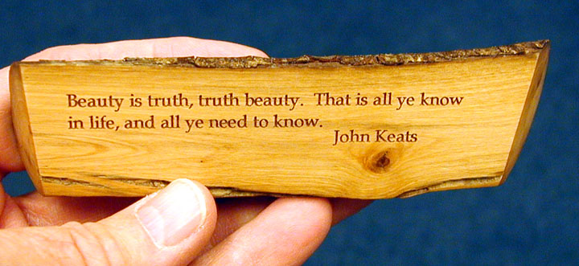
美即真，真即美——浪漫主义

Slide 86
…the Olympian Lightener summoned all the immortal gods to lofty Olympus and said that whoever of the gods fought the Titans on his side would not be deprived of their prerogatives, and each would have the honor as before among the immortal gods. Zeus said that he who was dishonored and without privileges under Kronos would gain honor and privileges, as is right.
奥林波斯的闪电之神宙斯曾把所有不死神灵召集到绵延的奥林波斯⼭，宣布任何 神只要随他对提坦作战，他就不⾰除其权利，让他们保有如前在神灵中所拥有的地位，凡是在克洛诺斯⼿下⽆职⽆权的神灵都将得到 公正的职务和权利。

Slide 87
The birth of Hecate
Phoebe went to Koios' bed of much desire. Then the goddess conceived in philotês with a god and bore dark-robbed Leto, always gracious, gentle to men and immortal gods, gracious from the beginning, most kindly within Olympus. She bore Asterie, of whom it is good to speak, whom Perses once led to his great house to be called his wife. Asterie conceived and bore Hekate, whom above all Zeus Kronides honored.
福柏与科俄斯恋爱结合，怀孕⽣了爱穿⿊⾊长袍的勒托。勒托性情温和，对⼈类和不死的神灵都和蔼友善，她⼀⽣下来就是如此 ，在奥林波斯诸神中她是最温柔的。福柏还⽣了名声很好的阿斯忒⾥亚。有⼀次珀⽿塞斯把阿斯忒⾥亚领进他的⾼⼤房间，称她为爱 妻。她怀孕⽣了赫卡忒——克洛诺斯之⼦宙斯最尊重的⼥神。

Slide 88
He granted her glorious gifts and to have a portion of the Gaia and unplowed sea. She has a portion also of the starry Ournaos as her province. She is especially honored among the immortals gods. For even now, when some one of men on earth, sacrificing beautiful victims, propitiates the gods in the customary way, he calls upon Hekate. Much honor follows him easily whose prayers the goddess eagerly accepts. She gives him blessings, since it is in her power. She has a share with all the immortals who were born from Gaia and Ouranos and received honor.
宙斯赠赫卡忒以贵重的礼物，让她共有⼤地和不产⾕物的海洋；她还在 繁星点缀的天宇获得荣誉，极受永⽣众神的敬重。直到今天，⽆论什么时候⼤地上的任何⼀个⼈按照风俗奉崐献祭品和祈求恩惠，都 呼唤赫卡忒的名字。赫卡忒乐意接受谁的祈求，这⼈就能轻易地多次得到荣誉；她还能给这⼈财富，因为她确有这种权⼒。象地神和 天神所⽣的众多后代⼀样，她在他们那结⽅⾯也都有⾃⼰应有的⼀份。

Slide 89
Kronides never did her violence or took from her what she had from the distribution among the former Titans, but she retained all as the distribution was first done. Although only-begotten, the goddess did not receive a lesser share of honor and privileges in the earth and Ouranos and sea, but yet even more, since Zeus honors her. She comes and greatly aids whatever man she prefers and at trials sits beside revered kings. In the marketplace, that man whom she prefers is preeminent among people. Whenever men arm for man-slaying war, then the goddess comes beside those whom she prefers, eagerly granting victory and holding out glory.
克洛诺斯之⼦从未伤害过她，也没有从她在前辈的提坦神中 所得到的⼀切⾥拿⾛任何东西。还和起初分配的⼀样，她在⼤地、天空和海洋中拥有⾃⼰的⼀份。还因为她是阿斯忒⾥亚唯⼀的孩⼦ ，所以她得到的荣誉不但没有减少，反⽽由于宙斯对她的尊重⽽增加了很多。只要她乐意，她就能给谁很⼤的帮助和很多的好处：如 此她坐到令⼈敬佩、主持裁判的国王⾝旁，她乐意帮助的那个⼈就会在法庭上惹⼈注⽬。⼈类之间若爆发毁灭性的战争，这位⼥神就 会来到战场上，让她乐意帮助的⼈获得胜利，赢得荣誉。

Slide 90
Good is she at standing beside horsemen she prefers. Good again is she when men compete in the contest. There the goddess comes beside and aids them. He who has won by brute force and power carries the beautiful prize off lightly and joyfully and confers honor upon his parents. Upon those who work the rough grey sea and pray to Hekate and loud-rumbling Earth Shaker, easily does the glorious goddess confer a larger catch. Lightly, too, if it is her wish, she takes away one appearing before them.
⼈类进⾏各种⽐赛时，她也是有益的，因为她会来到他们中间帮助他们。于 是，凭能⼒赢得胜利的⼈将轻⽽易举⾼⾼兴兴地获得贵重的奖品，并给⽗母带来光荣。她乐意站在决⼼帮助的骑⼠⾝旁时，对他们也 是有益的。她对那些在乌云密布波涛翻滚的⼤海上谋⽣的⼈也是有益的，谁向她和震⽿欲聋的地震之神祈祷，这位光荣的⼥神就能轻 ⽽易举地让他⼤发其财；如果她⾼兴，她也能易如反掌地使他瞬息间得⽽复失。

Slide 91
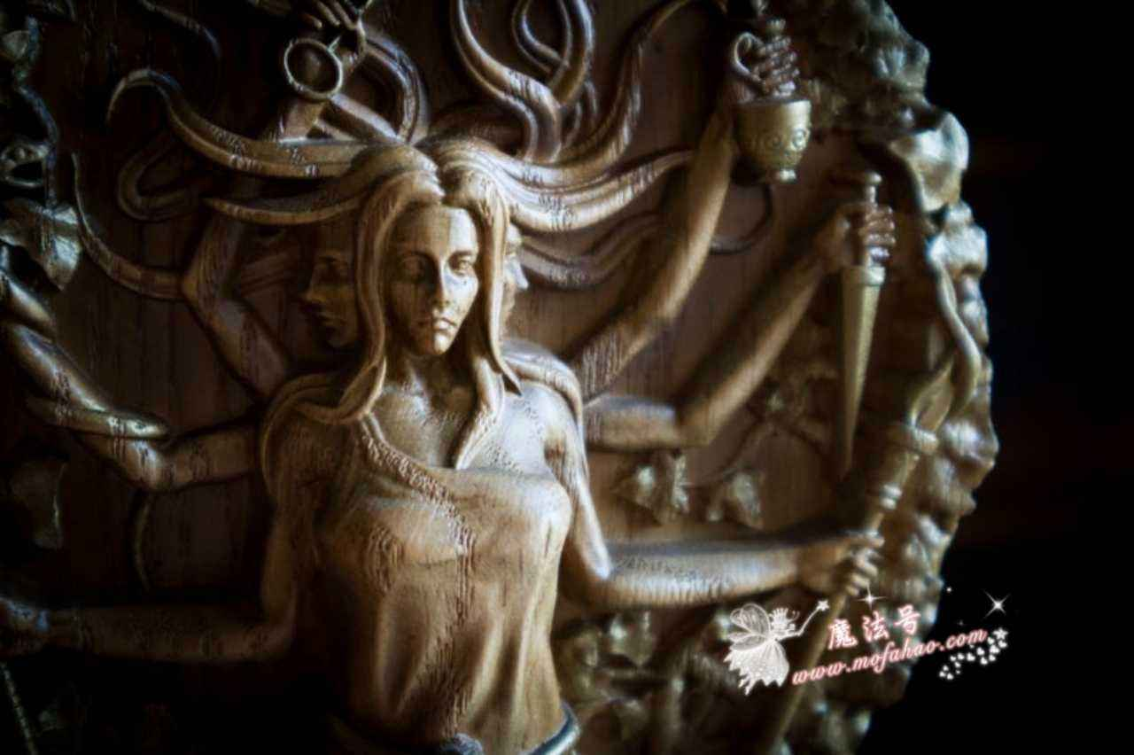
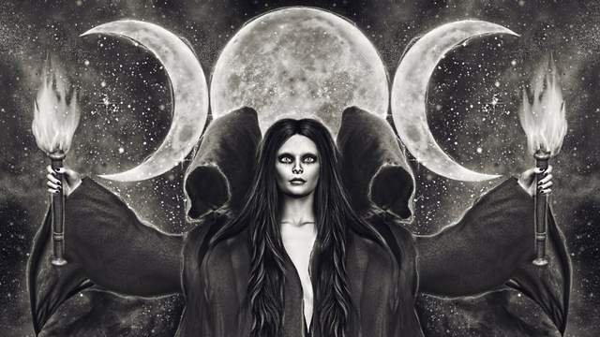
Hecate
Hecate, goddess accepted at an early date into Greek religion but probably derived from the Carians in southwest Asia Minor. In Hesiod she is the daughter of the Titan Perses and the nymph Asteria and has power over heaven, earth, and sea; hence, she bestows wealth and all the blessings of daily life. Hecate was the chief goddess presiding over magic and spells. She witnessed the abduction of Demeter’s daughter Persephone to the underworld and, torch in hand, assisted in the search for her. Thus, pillars called Hecataea stood at crossroads and doorways, perhaps to keep away evil spirits.

Slide 92
Noble is she in the stables with Hermes to increase the herds. Herds of cattle, broad flocks of goats and wooly sheep, if it is her wish in her spirit, she enlarges from small and diminishes from many. Thus, even being the only begotten of her mother, she is honored with privileges among all the immortals. Kronides made her Nurturer of Youths who after her with their eyes saw the light of much-seeing Dawn. Thus from the beginning she was Nurturer of Youths, and these are her provinces.
她与赫尔墨斯⼀起呆在⽜栏⾥也是有益的，能使家畜 繁殖增产。如果她⾼兴，她可以使⽜⽺由少变多或由多变少。因此，尽管她是⾃⼰母亲的唯⼀孩⼦，但在所有永⽣神灵中受到尊敬。 克洛诺斯之⼦分派她为年轻⼈的抚育者。所有在那天之后⽤⾃⼰眼睛看见多识的黎明⼥神的曙光的孩⼦们的教育者。因此，她⼀开始 便是年轻⼈的抚育者。以上这些都是赫卡忒的荣誉。

Slide 93
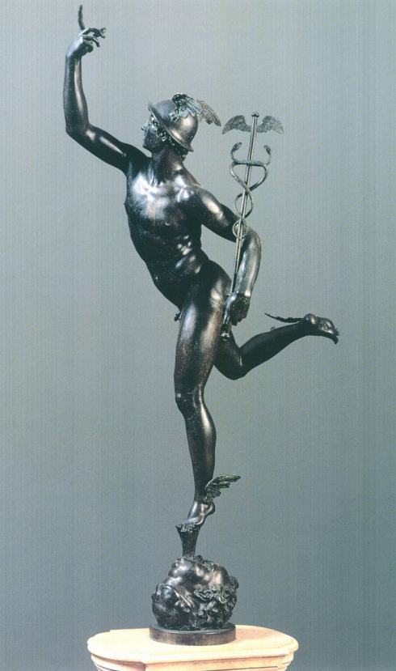
Hermes
Hermes, Greek god, son of Zeus and the Pleiad Maia; often identified with the Roman Mercury and with Casmilus or Cadmilus, one of the Cabeiri. His name is probably derived from herma (see herm), the Greek word for a heap of stones, such as was used in the country to indicate boundaries or as a landmark. The earliest centre of his cult was probably Arcadia, where Mt. Cyllene was reputed to be his birthplace. There he was especially worshipped as the god of fertility, and his images were ithyphallic.

Slide 94
Rheia,subdued by Kronos, bore illustrious children, Hestia and Demeter and golden-sandaled Hera and mighty Hades who dwells in houses beneath the earth, having a pitiless heart, and loud rumbling Earth Shaker, and Zeus of counsels, father of gods and men, beneath whose thunder the wide earth quivers. Great Kronos kept swallowing them as each arrived at his mother's knees from her sacred womb, intending that no other one of the illustrious children of Ouranos hold the kingly province among the immortals.
瑞亚被迫嫁给克洛诺斯为妻，为他⽣下了出⾊的⼦⼥：赫斯提亚、德墨特尔、脚穿⾦鞋的赫拉、冷酷⽆情住在地下的强⼤的哈得 斯，震动⼤动轰隆作响的波塞顿和⼈类与诸神之⽗英明的宙斯——其雷声能够震动⼴阔的地⾯。每个孩⼦⼀出世，伟⼤的克洛诺斯便 将之吞⾷，以防其他某⼀骄傲的天空之神成为众神之王；

Slide 95
for he learned from Gaia and starry Ouranos that it was fated for him to be subdued by his son, although he himself was powerful, through the plans of great Zeus. Therefore, he kept no blind vigilance but, awaiting each, he would swallow his children. Rheia had pain not to be forgotten. But when she was about to bear Zeus, father of gods and men, she beseeched her parents, Gaia and starry Ouranos, to contrive a scheme so that she might give birth to her son in secret and make great Kronos of crooked counsel pay her father's avenging Fury and that of the children he swallowed.
因为克洛诺斯从群星点缀的乌兰诺斯和地神该亚那⾥得知，尽管他很强⼤， 但注定要为⾃⼰的⼀个⼉⼦所推翻。克洛诺斯因此提⾼警惕，注意观察，把⾃⼰的孩⼦吞到肚⾥。其妻瑞亚为此事悲痛不已。诸神和 ⼈类之⽗宙斯将要出世时，瑞亚恳求⾃⼰亲爱的⽗母——头戴星冠的乌兰诺斯和地神该亚，替她想个办法，以便把这个亲爱的孩⼦的 出世瞒过，让他将来推翻强⼤狡猾的克洛诺斯，为天神乌兰诺斯和被吞⾷的孩⼦们报仇。

Slide 96
They listened to their daughter and obeyed, and informed her what was fated to happen for Kronos, king and powerful hearted son. They sent Rheia to Lyktos, to the fat country of Krete, when she was about to give birth to the last of her children, great Zeus. Monstrous Gaia received him in broad Krete to nourish and foster. There she arrived, carrying him through the swift black night, first to Lyktos. Holding him in her arms, she hid him in a high cave, beneath the ways of divine Gaia, on densely wooded Mount Aigiaon.
他们俩爽快地听从了爱⼥的建议，把关于克 洛诺斯及其勇敢⼉⼦注定要发⽣的⼀切告诉了她。在她快要⽣下最⼩的⼉⼦、强⼤的宙斯时，他们把她送到吕克托斯——克⾥特岛上 的⼀个富庶的村社。⼴阔的⼤地从瑞亚⼿⾥接过宙斯，在⼴⼤的克⾥特抚养他长⼤。在⿊夜的掩护下，地神⾸先带着他迅速来到吕克 托斯，抱着他在森林茂密的埃该昂⼭中找到⼀处偏僻的秘密地下洞⽳，将他藏在这⾥。

Slide 97
She wrapped a stone in swaddling clothes entrusted it to Ouranos' son and great lord, king of gods before, He took it and put in down into his womb, cruel one, and he did not realize it in his mind, so that in return for a stone, his son remained unconquered and unconcerned, who was going to subdue him by brute force and his hands and drive him from his province and lord among immortals. Rapidly the strength and the limbs in their glory of the lord grew, and when the year in its cycle came around, deceived by Gaia's sagacious advice, Kronos of crooked counsel sent up his offspring again, conquered by the schemes and brute force of his son. He vomited the stone first, swallowing it last.
之后，瑞亚把⼀块⼤⽯头裹在襁褓中，送给 强⼤的统治者天神之⼦，诸神之前王克洛诺斯。他接过襁褓，吞进腹中。这个倒霉的家伙!他⼼⾥不知道吞下去是⽯块，他的⼉⼦存 活下来，即没有被消灭，也没有受到威胁。这个⼉⼦不久就要凭强⼒打败他，剥夺他的⼀切尊荣，取⽽代之成为众神之王。 那以后，这位王⼦的⽓⼒和体格迅速增长。随着时间的推移，狡猾强⼤的克洛诺斯被⼤地⼥神的巧妙提议所蒙骗，重新抚养这个 ⼉⼦，[被这个⼉⼦⽤计谋和武⼒所征服，]他⾸先吐出了那块最后吞下的⽯头。

Slide 98
And it Zeus fixed in the broad-wayed earth, in hallowed Pytho beneath the vales of Parnassos, to be a sign hereafter, a wonder for mortal men. He loosened his father's brothers from destructive bonds, sons of Ouranos, whom their father bound in his folly. They remembered gratitude for his benefactions and gave him thunder and gleaming lightning and flash. Before, monstrous Gaia hid them. Relying upon these, Zeus lords over mortals and immortals.
宙斯将这块⽯头安放在道路宽⼴的⼤地上，帕⽿那索 斯幽⾕中风景优美的⽪托，以后给凡⼈作为信物和奇迹。宙斯释放了天神之⼦他⽗亲的兄弟们，这些神曾被他⽗亲愚蠢地捆绑起来， 现在他解开了他们⾝上可怕的绳索。他们不忘感谢他的好意，赠给他闪电和霹雳；⽽此前，庞⼤的地神曾把它们藏匿。宙斯倚靠它们统治着神灵和凡⼈。

Slide 99
Iapetos led the daughter of Okeanos, beautiful-ankled Klymene and went with her up to the same bed. She gave birth to a son Atlas and produced the exceedingly glorious Menoitios and Prometheus, changeful, slippery-counseled, and erring-minded Epimetheus who proved an evil for men who eat what the soil yields. He was first to receive under his roof Zeus's molded woman virgin. Wide-seeing Zeus sent insolent Menoitios down into Erebos, striking him with smoldering lightning, because of his rashness and excessive manliness. Atlas holds wide Heaven beneath powerful necessity, standing on the boundaries of the Gaia before the clear-toned Hesperides, on his head and weariless arms. This portion counselor Zeus distributed to him.
伊阿佩托斯娶⼤洋神之⼥、美踝的克吕墨涅为妻，双双同床共枕。克吕墨涅给他⽣下了勇敢⽆畏的阿特拉斯，以及⼗分光荣的墨 诺提俄斯、⾜智多谋的普罗⽶修斯、⼼不在焉的厄庇⽶修斯。厄庇⽶修斯当初娶宙斯创造的少⼥（潘多拉）为妻，开始给以五⾕为⾷ 的⼈类带来了灾难。墨诺提俄斯残暴凶狠，⽬光看得见远处的宙斯⽤可怕的霹雳轰击他，把他抛⼊厄瑞玻斯（⿊暗），因为他⼗分傲 慢，过于放肆。阿特拉斯在⼤地的边缘，站在嗓⾳清晰的赫斯珀⾥得斯姊妹⾯前，⽤不倦的头颅和双臂⽆可奈何地⽀撑着⼴⼤的天宇 ——英明的宙斯为他安排了这个命运……

Slide 100
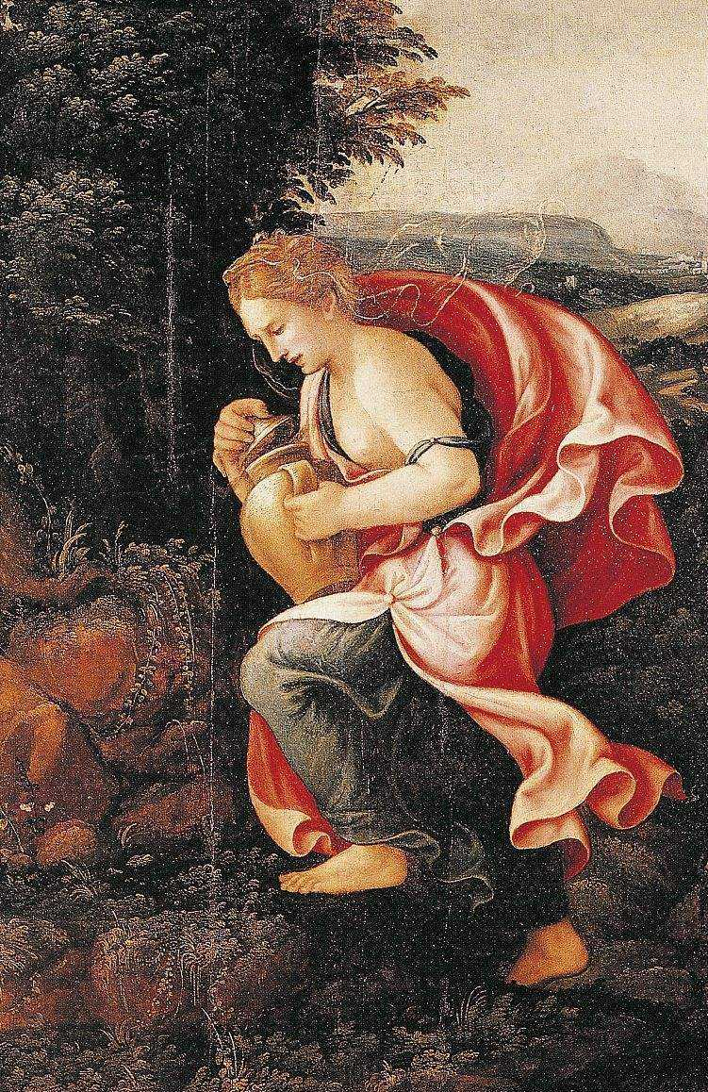
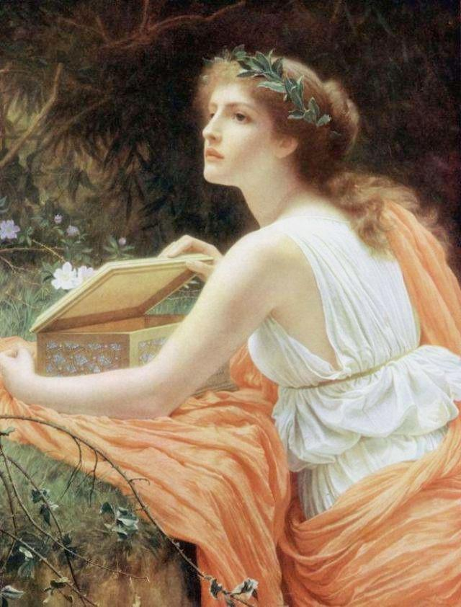
Pandora, (Greek: “All-Gifts”) in Greek mythology, the first woman. According to Hesiod’s Theogony, after Prometheus, a fire god and divine trickster, had stolen fire from heaven and bestowed it upon mortals, Zeus, the king of the gods, determined to counteract this blessing. He accordingly commissioned Hephaestus (a god of fire and patron of craftsmen) to fashion a woman out of earth, upon whom the gods bestowed their choicest gifts. In Hesiod’s Works and Days, Pandora had a jar containing all manner of misery and evil. Zeus sent her to Epimetheus, who forgot the warning of his brother Prometheus and made her wife.

Slide 101
He bound the changeful-planning Prometheus with unbreakable fetters, painful bonds, and drove them through the middle of a pillar. And he sent a long-winged eagle upon him. Further, it ate his deathless liver, but there grew back all over during the night as much as the bird of long wings had eaten during the whole whole day. The stout son of Alkmene of the beautiful ankles, Heracles, slew it, and warded off the evil sickness for Iapetos' son and released him from troubles, not against Olympian Zeus's will, who was contriving on high in order that the renown of Theban-born Heracles might be more than before over the much-nourishing earth. So respecting him, he honored his conspicuous son.
宙斯⽤挣脱不了的绳索和⽆情的锁链捆绑着⾜智多谋和普罗⽶修斯，⽤⼀⽀长⽭剖开他的胸膛 ，派⼀只长翅膀的⼤鹰停在他⾝上，不断吸⾷他那不死的肝脏。虽然长翅的⼤鹰整个⽩天啄⾷他的肝脏，但夜晚肝脏⼜恢复到原来这 么⼤。美踝的阿尔克墨涅的勇敢之⼦赫拉克勒斯杀死了这只⼤鹰，让这位伊阿珀托斯之⼦摆脱了它的折磨，解除了痛苦——这⾥不⽆ 奥林波斯之王宙斯的愿望。为此，忒拜出⽣的赫拉克勒斯在丰产⼤地上的声誉更胜以往。

Slide 102
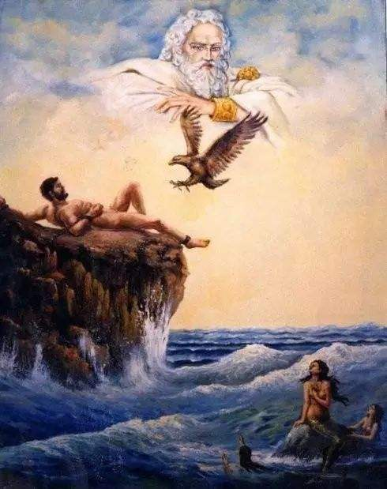
Prometheus, in Greek religion, one of the Titans, the supreme trickster, and a god of fire. His intellectual side was emphasized by the apparent meaning of his name, Forethinker. In common belief he developed into a master craftsman, and in this connection he was associated with fire and the creation of mortals.

Slide 103
Although angry, he let off the wrath he had before against Prometheus because he rivaled the very mighty Kronios in designs. For when gods and mortal men were making a settlement at Mekone, at that time Prometheus divided with eager spirit a great ox and set it before him, seeking to beguile the mind of Zeus. For him, Prometheus covered flesh and innards rich in fat with the ox's stomach and set them down wrapped in the hide.For them, he covered the ox's white bones with shining fat and, well arranging them for his cunning trick, set them down. Then the father of men and gods addressed him:“Son of Iapetos, most conspicuous of all lords, dear sir, how partially you divided the portions.” Thus spoke Zeus who knows imperishable counsels, chiding him.
宙斯考虑到这给他那卓越⼉⼦带来的荣誉， 尽管对普罗⽶修斯仍然很⽓愤，但还是捐弃了前嫌——那是由于普罗⽶修斯竟与他这位克洛诺斯的万能之⼦⽐赛智慧⽽产⽣的愤怒。 事情是这样：当初神灵与凡⼈在墨科涅发⽣争执，普罗⽶修斯出来宰杀⼀头⼤⽜，分成⼏份摆在他们⾯前。为想蒙骗宙斯的⼼，他把 ⽜⾁和肥壮的内脏堆在⽜⽪上，放在其他⼈⾯前，上⾯罩以⽜的瘤胃，⽽在宙斯⾯前摆了⼀堆⽩⾻，巧妙堆放之后蒙上了⼀层发亮的 脂肪，这时凡⼈和诸神之⽗对他说： “伊阿佩托斯之⼦，最光荣的神灵，亲爱的朋友，你分配得多么不公平啊!” 智慧⽆穷的宙斯这样责备了他。

Slide 104
Again, Prometheus of crooked counsel addressed him, smiling slightly, and he did not forget his cunning trick:“Very noble Zeus, greatest of the gods who are for always, choose whichever of these the spirit in your breast bids you.”He spoke, planning cunning. Zeus who knows imperishable counsels recognized and was not ignorant of the cunning, but he eyed evils with his mind for mortal men, that he intended to fulfil. With both hands, he took the white fat,and grew angry around his breast, and bitter bile entered his mind when he saw the ox's white bones in a cunning trick. From then on, for the immortals the tribes of men on earth burn white bones on fragrant altars.
但是，狡猾的普罗⽶修斯微微⼀笑，没忘记诡诈的圈套，说： “宙斯，永⽣神灵中最荣耀、最伟⼤者，你可以按照⾃⼰的⼼意，随便挑取任何⼀份。”他这样说吧，⼼⾥却想着⾃⼰布置的圈 套。智慧⽆穷的智斯看了看，没有识破他的诡计，因为他这时⼼⾥正在想着将要实现的惩罚凡⼈的计划。宙斯双⼿捧起⽩⾊脂肪时， 看到了巧妙布置⽤以欺骗他的⽩⾻，不由地⼤怒起来——正是由于这次事件，以后⼤地上的凡⼈遂在芳⾹的圣坛上焚烧⽩⾻献祭神灵 。

Slide 105
Outraged, the cloud-gatherer Zeus addressed him:“Son of Iapetos, knowing counsels above all others, dear sir, you did not yet forget your trick.” Thus spoke Zeus who knows imperishable counsels, angered. From this time, always mindful of his wrath, he would not give the strength of weariless fire to the ash trees for mortal men who dwell on earth. But good son of Iapetos deceived him, stealing the far-seen beam of weariless fire in a hollow fennel stalk. It stung anew Zeus high thunderer in his spirit, and he raged in his heart when he saw among men the far-seen beam of fire.
但是驱云神宙斯⼤为恼怒，对他说道： “伊阿佩托斯之⼦，聪敏超群的朋友!你仍然没有忘记玩弄花招!” 智慧⽆穷的宙斯愤怒地说了这番话。此后，他时刻谨防受骗，不愿把不灭的⽕种授予居住在地上的墨利亚的会死的⼈类。但伊阿 佩托斯的⾼贵⼉⼦瞒过了他，⽤⼀根空茴⾹杆偷⾛了远处即可看见的不灭⽕种。⾼处打雷的宙斯看到⼈类中有了远处可见的⽕光，精 神受到刺激，内心感到愤怒。

Slide 106
Straightway, in return for fire he fashioned an evil for men. For the renowned Lame One molded from Gaia a likeness of majestic maiden through the plans of Kronides. Goddess gray-eyed Athena girded and dressed her in a silvery white garment. Down from her head, she drew with her hands a veil skillfully wrought, a wonder to behold. [About her head Pallas Athena put fresh-budding garlands, flowers of the meadow, desirable things, around her head.]About her, she put a golden band on her head that the renowned Lame One himself had made, working it with his hands, while pleasing his father Zeus. On it he had fashioned many skillful things, a wonder to behold, beasts as many as land and sea nourish, dreadful things. He put many of them on it, and grace breathed in all, wondrous, very like to living animals with voices.
他⽴即给⼈类制造了⼀个祸害，作为获得⽕种的代价。按照克洛诺斯之⼦的愿望，著名跛⾜神⽤泥⼟塑 造了⼀位腼腆的少⼥形象，明眸雅典娜给好穿上银⽩⾊的⾐服，亲⼿把⼀条漂亮的刺绣⾯纱罩在她的头上;雅典娜还把 ⽤刚开的鲜花编成的美丽花环套在她头颈上。]还⽤⼀条⾦带为她束发，这是著名跛⾜神为讨好其⽗亲⽽亲⽤制作的礼物。这发带是 ⼀件⾮常稀帘的⼯艺品，看上去美极了。因为这位匠神把陆地上和海洋⾥⽣长的⼤部分动物都缕在上⾯，妙极了，好象都是活的，能 叫出声⾳，还闪烁着灿烂的光彩。

Slide 107
When he fashioned a good evil in return for something noble, he led her out to where the other gods and men were, her adorned in the garment the gray-eyed Daughter of a Mighty Father. Wonder held immortal gods and mortal men, when they saw a sheer cunning, unmanageable for men. For from her is the descent of female women [for the race and tribes of women are destructive,]a great pain for mortals, living with men, companions not of destructive Poverty but of Plenty.
匠神既已创造了这个漂亮的灾星报复⼈类获得⽕种，待他满意于伟⼤⽗亲的明眸⼥⼉给这少⼥的装扮后，便把她送到别的神灵和 ⼈类所在的地⽅。虽然这完全是个圈套，但不朽的神灵和会死的凡⼈见到她时都不由地惊奇，凡⼈更不能抵挡这个尤物的诱惑。 她是娇⽓⼥性的起源，[是可怕的⼀类妇⼥的起源，]这类⼥⼈和会死的凡⼈⽣活在⼀起，给他们带来不幸，只能同享富裕，不能 共熬可恨的贫穷。

Slide 108
He gave another evil in return for something noble. Whoever, fleeing marriage and women's mischievous deeds, chooses not to marry comes to destructive old agewithout someone to tend to his old age. He lives in want of nothing, but when he dies, distant relatives divide up his property. For that man whose lot it is to marry and have a trusty wife, one suited to his ways, evil unceasingly rivals good from his prime (?). Whoever gets a baneful type lives with an unremitting sorrow on his spirit and heart, and it is an evil incurable. Thus, there is no deceiving Zeus's mind nor getting by it. For not even the son of Iapetos, akakêta (?) Prometheuse scaped his heavy bile, but beneath necessity him, although very clever, a great bond restrained.
他⼜给⼈类制造了第⼆个灾难：如果有谁想独⾝和逃避⼥⼈引起的悲苦，有谁不愿结婚，到了可怕的晚年就不会有⼈供 养他；尽管他活着的时候不缺少⽣活资料，然⽽等他死了，亲戚们就会来分割他的遗产。如果⼀个⼈挑选了结婚的命运，并且娶了⼀ 个称⼼如意的妻⼦，那么对于这个男⼈来说，恶就会不断地和善作⽃争；因为如果他不巧⽣了个淘⽓的孩⼦，他就会下半辈⼦烦恼痛 苦得没完没了。这种祸害是⽆法排除的。 因此，欺骗宙斯和蒙混他的⼼志是不可能的。即使象伊阿佩托斯之⼦、善良的普罗⽶修斯那么⾜智多谋，也没有能逃脱宙斯的 盛怒，且受到了他那结实锁链的惩处。

Slide 109
When first father Ouranos was angered in his spirit at Obriareus and Kottos and Gyges, he bound them in evil chains, envying their excessive manhood and shape and size. He settled them beneath broad-wayed earth. There dwelling beneath the earth in pain, they sat at the farthest ends on the limits of great Gaia, grieving deeply and having great sorrow in their heart. But Kronides and the other immortal gods whom beautiful-haired Rheia bore in philotês with Kronos, in accord with Gaia's advice, brought them into the light again…
当初乌兰诺斯讨厌他的孩⼦布⾥阿瑞俄斯、科托斯和古埃斯，忌妒他们超凡的勇⽓、惊⼈的美貌和⾼⼤的⾝材，竟残忍地将他们 捆绑起来，流放到道路宽阔的⼤地的下⾯。他让他们长期住在陆地的未端，这⼤地的边缘，在那⾥受尽折磨，⼗分痛苦，内⼼极其悲 伤。但是，宙斯联合浓发瑞亚与克洛诺斯所⽣的其他不死神祗，按照⼤地⼟神该亚的忠告，把他们重新带到阳光普照的地上世界……

Slide 110
Then among the foremost they aroused bitter battle, Kottos and Briareos and Gyges, insatiate of war. Three hundred rocks from their sturdy hands they were hurling, one on another, and they cast shadows over the Titans with missiles. They sent them beneath broad-wayed earth and bound them in painful bonds, having conquered them by hands, though they were bold, as far beneath the earth as Ouranos is above Gaia so far from earth to murky Tartaros…
好战的科托斯、布⾥阿瑞俄斯和古埃斯排在最前⾯，他们的攻势猛烈。三百块⼤⽯，⼀块接⼀块地从他们强壮的⼤⼿⾥投出， 压倒了提坦神的⽕⼒。凭着⽆⽐的勇敢和巨⼤的⼒⽓征服了提坦族之后，他们将之抛⼊道路宽阔的⼤地下⾯的塔⽿塔罗斯，⽤不堪忍 受的铁链把提坦神锁在那⾥。塔⽿塔罗斯与⼤地相距很远，从⼤地到下⾯的塔⽿塔罗斯和从⼤地到上⾯的天空有相等的距离……

Slide 111
Around its neck, night in three rows is spread. From above grow the roots of earth and the unplowed sea. There the Titan gods beneath the murky darkness have been hidden by the plans of cloud-gathering Zeus, in that squalid place, the ends of monstrous Gaia. There is no exit for them, but Poseidon put on gates of bronze, and a wall runs on around from both sides. There Gyges and Kottos and great-spirited Obriareos, dwell, faithful guards of aegis-bearing Zeus…
塔⽿塔罗斯周围有⼀道青铜栅栏，夜幕三重如项圈⼀般包围着它，⼤地和不产果实的海洋之根就⽣在其上。根据驱云神宙斯的主意， 提坦神被困在那⾥，阴暗的地下，⼤地末端⼀块阴暗潮湿的地⽅。波塞顿装上青铜⼤门，还有⼀道⾼墙环绕四周。古埃斯、科托斯和 ⼤胆的布⾥阿瑞俄斯住在那⼉，充当神盾持有者宙斯的忠实看守⼈……

Slide 112
Zeus, king of gods, made Metis his first wife, most knowledgeable of gods and immortal men. But when she was about to bear Athena of gleaming eyes, then by a cunning he deceived her mind with coaxing words and put her down into his womb, in accord with the advice of Gaia and starry Ouranos. Thus they told him in order that the kingly province no other of the gods who are for always might hold instead of Zeus. For it was fated that from her would be born thoughtful children. First, a maiden, gleaming-eyed Tritogeneia who has might and keen plans equal to her father. Then Metis was going to bear a son to be king of gods and men, having a very forceful heart. But Zeus sent her down into his womb before then so that the goddess might advise him on good and evil.
现在，诸神之王宙斯⾸先娶墨提斯为妻，她是神灵和凡⼈中最聪明的⼈。在她就要⽣产明眸⼥神雅典娜时，根据星光灿烂的乌兰 诺斯和该亚的忠告，宙斯花⾔巧语地骗过了她，将她吞进了⾃⼰的肚⾥。他们之所以建议宙斯这样做，是为了不让别的神灵垡宙斯取 得永⽣神灵中的王位；因为墨提斯注定会⽣下⼏个绝顶聪明的孩⼦，第⼀个是明眸少⼥特⾥托⾰尼亚，她在⼒量和智慧两⽅⾯都与她 的⽗王相等。但这之后，墨提斯将⽣⼀位傲岸的⼉⼦做众神和⼈类之王。然⽽，宙斯抢先把她吞进了⾃⼰肚⾥，让这位⼥神可以替他 出主意，逢凶化吉。

Slide 113
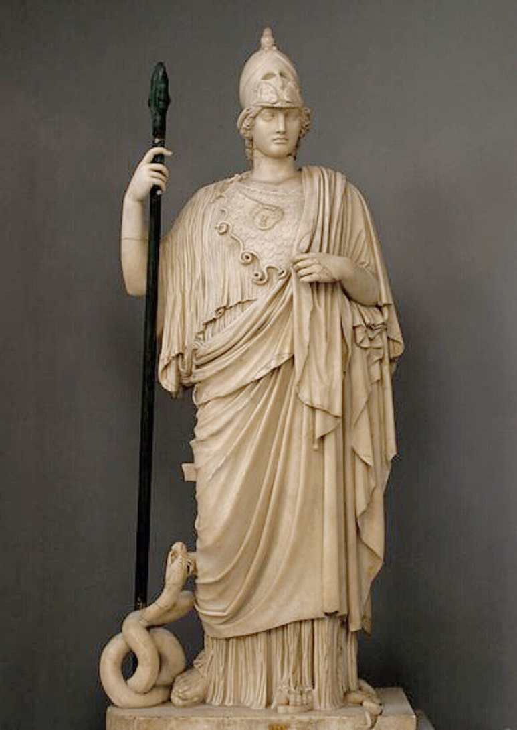
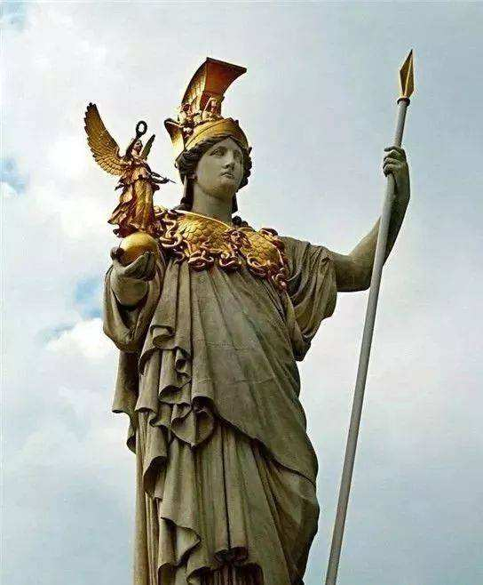
Metis and Athena

Slide 114
Athena, also spelled Athene, in Greek religion, the city protectress, goddess of war, handicraft, and practical reason, identified by the Romans with Minerva. She was essentially urban and civilized, the antithesis in many respects of Artemis, goddess of the outdoors. Athena was probably a pre-Hellenic goddess and was later taken over by the Greeks. Yet the Greek economy, unlike that of the Minoans, was largely military, so that Athena, while retaining her earlier domestic functions, became a goddess of war.

Slide 115
Athena’s association with the acropolises of various Greek cities probably stemmed from the location of the kings’ palaces there. She was thought to have had neither consort nor offspring. She may not have been described as a virgin originally, but virginity was attributed to her very early and was the basis for the interpretation of her epithets Pallas and Parthenos. As a war goddess Athena could not be dominated by other goddesses, such as Aphrodite, and as a palace goddess she could not be violated.

Slide 116
In Homer’s Iliad, Athena, as a war goddess, inspires and fights alongside the Greek heroes; her aid is synonymous with military prowess. Also in the Iliad, Zeus, the chief god, specifically assigns the sphere of war to Ares, the god of war, and Athena. Athena’s moral and military superiority to Ares derives in part from the fact that she represents the intellectual and civilized side of war and the virtues of justice and skill, whereas Ares represents mere blood lust. Her superiority also derives in part from the vastly greater variety and importance of her functions and from the patriotism of Homer’s predecessors, Ares being of foreign origin.

Slide 117
In the Iliad, Athena is the divine form of the heroic, martial ideal: she personifies excellence in close combat, victory, and glory. The qualities that lead to victory are found on the aegis, or breastplate, that Athena wears when she goes to war: fear, strife, defense, and assault. Athena appears in Homer’s Odyssey as the tutelary deity of Odysseus, and myths from later sources portray her similarly as helper of Perseus and Heracles(Hercules). As the guardian of the welfare of kings, Athena became the goddess of good counsel, of prudent restraint and practical insight, as well as of war.

Slide 118
In post-Mycenaean times the city, especially its citadel, replaced the palace as Athena’s domain. She was widely worshipped, but in modern times she is associated primarily with Athens, to which she gave her name. Her emergence there as city goddess, Athena Polias (“Athena, Guardian of the City”), accompanied the ancient city-state’s transition from monarchy to democracy. She was associated with birds, particularly the owl, which became famous as the city’s own symbol, and with the snake. Her birth and her contest with Poseidon, the sea god, for the suzerainty of the city were depicted on the pediments of the Parthenon, and the great festival of the Panathenaea, in July, was a celebration of her birthday. She was also worshipped in many other cities, notably in Sparta.

Slide 119
Athena became the goddess of crafts and skilled peacetime pursuits in general. She was particularly known as the patroness of spinning and weaving. That she ultimately became allegorized to personify wisdom and righteousness was a natural development of her patronage of skill.

Slide 120
Next he married bright Themis who bore the Horae (Hours), and Eunomia (Order), Dikë (Justice), and blooming Eirene (Peace), who mind the works of mortal men, and the Moerae (Fates) to whom wise Zeus gave the greatest honor, Clotho, and Lachesis, and Atropos who give mortal men evil and good to have. And Eurynome, the daughter of Ocean, beautiful in form, bore him three fair-cheeked Charites (Graces), Aglaea, and Euphrosyne, and lovely Thaleia, from whose eyes as they glanced flowed love that unnerves the limbs: and beautiful is their glance beneath their brows.
第⼆个，宙斯娶了容光照⼈的忒弥斯为妻，⽣下了荷赖（时序三⼥神），即欧诺弥亚（秩序⼥神）、狄刻（正义⼥神）和鲜花怒 放的厄瑞涅（和平⼥神）。这些⼥神关⼼凡⼈的⼯作。他俩还⽣了摩伊赖（命运三⼥神），英明的宙斯授予她们最⾼荣誉。这三位⼥ 神是克洛索、拉赫西斯和阿特洛泊斯，她们使⼈⽣有幸与不幸。 ⼤洋神之⼥、长相漂亮的欧律诺墨为宙斯⽣了脸蛋可爱的美惠三⼥神——阿格莱亚、欧佛洛绪涅和讨⼈喜欢的塔利亚。她们顾盼 之间含情脉脉，令⼈销魂荡魄。她们动⼈之处在于眉⽑下的那双眼睛的秋波。

Slide 121
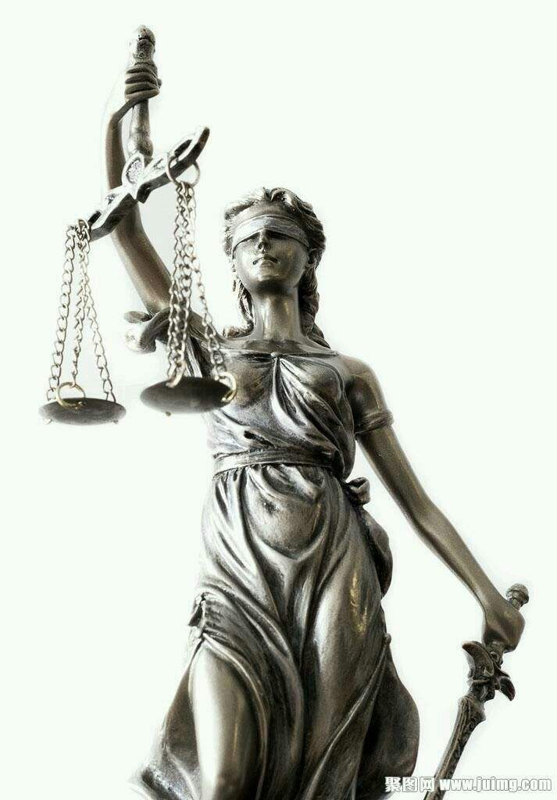
Themis, (Greek: “Order”) in Greek religion, personification of justice, goddess of wisdom and good counsel, and the interpreter of the gods’ will. On Olympus, Themis maintained order and supervised the ceremonial. She was a giver of oracles; The cult of Themis was widespread in Greece. She was often represented as a woman of sober appearance carrying a pair of scales.

Slide 122
Also he came to the bed of all-nourishing Demeter, and she bore white-armed Persephone whom Aidoneus carried off from her mother; but wise Zeus gave her to him. And again, he loved Mnemosyne with the beautiful hair: and of her the nine gold-crowned Muses were born who delight in feasts and the pleasures of song. And Leto was joined in love with Zeus who holds the aegis, and bore Apollo and Artemis delighting in arrows, children lovely above all the sons of Heaven. Lastly, he made Hera his blooming wife: and she was joined in love with the king of gods and men, and brought forth Hebe and Ares and Eileithyia. But Zeus himself gave birth from his own head to bright-eyed Tritogeneia, the awful, the strife-stirring, the host-leader, the unwearying, the queen, who delights in tumults and wars and battles.
宙斯也和丰产的德墨特尔同床共枕，⽣下⽩臂⼥神珀⽿塞福涅；哈得斯把她从其母⾝旁带⾛，英明的宙斯将她许配了他。 此外，宙斯与美发的谟涅摩绪涅相爱，⽣下九个发束⾦带的神⼥缪斯，她们都喜欢宴欢和歌唱。 勒托也在恋爱中与神盾持有者宙斯结合，⽣下喜欢射箭的阿波罗和阿尔忒密斯。他们是宙斯所有⼦⼥中最可爱的两个。 最后，宙斯娶赫拉作宠妻。她与这位神⼈之王相爱，为他⽣了赫柏、阿瑞斯和爱勒提亚。 宙斯从⾃⼰头脑中⽣出明眸⼥神特⾥托⾰尼亚。她是⼀位可怕的、呼啸呐喊的将军，⼀痊渴望喧嚷和战争厮杀的不可战胜的⼥王 。

Slide 123

Demeter
Demeter, in Greek religion, daughter of the deities Cronus and Rhea, sister and consort of Zeus (the king of the gods), and goddess of agriculture. Her name indicates that she is a mother. Demeter is rarely mentioned by Homer, nor is she included among the Olympian gods, but the roots of her legend are probably ancient. The legend centres on the story of her daughter Persephone, who is carried off by Hades, the god of the underworld. Demeter goes in search of Persephone and, during her journey, reveals her secret rites to the people of Eleusis.

Slide 124


The rape of Persephone

Slide 125


Demeter and Persephone

Slide 126
the origin of seasons
Persephone comes back to Hades——winter
Persephone comes out——Spring
生殖女神的形象：“种子”，春天破土而出，秋收，冬藏……
Persephone and Eve

Slide 127


Leto and Delos

Slide 128


Apollo and Artemis

Slide 129
Apollo, byname Phoebus, in Greco-Roman mythology, a deity of manifold function and meaning, one of the most widely revered and influential of all the ancient Greek and Roman gods. Though his original nature is obscure, from the time of Homer onward he was the god of divine distance, who sent or threatened from afar; the god who made men aware of their own guilt and purified them of it; who presided over religious law and the constitutions of cities; and who communicated with mortals through prophets and oracles his knowledge of the future and the will of his father, Zeus (Roman: Jupiter). Even the gods feared him, and only his father and his mother, Leto (Roman: Latona), could easily endure his presence. He was also a god of crops and herds, primarily as a divine bulwark against wild animals and disease, as his Greek epithet Alexikakos (Averter of Evil) indicates. His forename Phoebus means “bright” or “pure,” and the view became current that he was connected with the Sun.

Slide 130
Among Apollo’s other Greek epithets was Nomios (Herdsman), and he is said to have served King Admetus of Pherae in the lowly capacities of groom and herdsman as penance for slaying Zeus’s armourers, the Cyclopes. He was also called Lyceius, presumably because he protected the flocks from wolves (lykoi); because herdsmen and shepherds beguiled the hours with music, scholars have argued that this was Apollo’s original role. In art Apollo was represented as a beardless youth, either naked or robed. Distance, death, terror, and awe were summed up in his symbolic bow. A gentler side of his nature, however, was shown in his other attribute, the lyre, which proclaimed the joy of communion with Olympus (the home of the gods) through music, poetry, and dance.

Slide 131
Though Apollo was the most Hellenic of all gods, he derived mostly from a type of god that originated in Anatolia and spread to Egypt by way of Syria and Palestine. Traditionally, Apollo and his twin, Artemis(Roman: Diana), were born on the isle of Delos. From there Apollo went to Pytho (Delphi), where he slew Python, the dragon that guarded the area. He established his oracle by taking on the guise of a dolphin, leaping aboard a Cretan ship, and forcing the crew to serve him. Thus, Pytho was renamed Delphi after the dolphin (delphis), and the Cretan cult of Apollo Delphinius superseded that previously established there by Earth (Gaea). During the Archaic period (8th to 6th century BCE), the fame of the Delphic oracle spread as far as Lydia in Anatolia and achieved Panhellenic status. The god’s medium was the Pythia, a local woman over 50 years old who, under his inspiration, delivered oracles in the main temple of Apollo. The oracles were subsequently interpreted and versified by priests. Other oracles of Apollo existed on the Greek mainland, on Delos, and in Anatolia, but none rivalled Delphi in importance.

Slide 132
Of the Greek festivals in honour of Apollo, the most curious was the octennial Delphic Stepterion, in which a boy reenacted the slaying of the Python and was temporarily banished to the Vale of Tempe.
Although Apollo had many love affairs, they were mostly unfortunate: Daphne, in her efforts to escape him, was changed into a laurel, his sacred shrub; Coronis (mother of Asclepius) was shot by Apollo’s twin, Artemis, when Coronis proved unfaithful; and Cassandra (daughter of King Priam of Troy) rejected his advances and was punished by being made to utter true prophecies that no one believed.

Slide 133
Artemis, in Greek religion, the goddess of wild animals, the hunt, and vegetation and of chastity and childbirth; she was identified by the Romans with Diana. Artemis was the daughter of Zeus and Leto and the twin sister of Apollo. Among the rural populace, Artemis was the favourite goddess. Her character and function varied greatly from place to place, but, apparently, behind all forms lay the goddess of wild nature, who danced, usually accompanied by nymphs, in mountains, forests, and marshes.

Slide 134
But Hera without union with Zeus--for she was very angry and quarrelled with her mate--bare famous Hephaestus, who is skilled in crafts more than all the sons of Heaven. But Hera was very angry and quarrelled with her mate. And because of this strife she bore without union with Zeus who holds the aegis a glorious son, Hephaestus, who excelled all the sons of Heaven in crafts. But Zeus lay with the fair-cheeked daughter of Ocean and Tethys apart from Hera…
赫拉没有和宙斯同房——因为她那时对宙斯⼗分⽣⽓，与他吵了架——⽣下了著名的赫淮斯托斯。他精于⼿⼯技艺，为宙斯的所有 其他⼦⼥的望尘莫及。 赫拉那时对宙斯⼗分⽣⽓，和他吵嘴。由于不和，赫拉未和神盾持有者宙斯结合便⽣下了⼀个光荣的⼉⼦赫淮斯托斯。他的⼿⼯ 技艺胜过宙斯的所有⼦⼥。但是，除赫拉外，宙斯还与俄刻阿诺斯和忒修斯的脸蛋漂亮的⼥⼉同床……

Slide 135


Zeus and Hera

Slide 136

Hera, the envious wife
Hera, in ancient Greek religion, a daughter of the Titans Cronus and Rhea, sister-wife of Zeus, and queen of the Olympian gods. The Romans identified her with their own Juno. Hera was worshipped throughout the Greek world and played an important part in Greek literature, appearing most frequently as the jealous and rancorous wife of Zeus and pursuing with vindictive hatred the heroines who were beloved by him. From early times Hera was believed to be the sole lawful wife of Zeus.

Slide 137
Hera appears to be the sublime embodiment of strict matronly virtue, and is on that account the protectress of purity and married women. Faultless herself in her fidelity as a wife, she is essentially the type of the sanctity of the marriage tie, and holds in abhorrence any violation of its obligations. So strongly was she imbued with this hatred of any immorality, that, finding herself so often called upon to punish the failings of both gods and men in this respect, she became jealous, harsh, and vindictive. Her exalted position as the wife of the supreme deity, combined with her extreme beauty, caused her to become exceedingly vain, and she consequently resented with great severity any infringement on her rights as queen of heaven, or any apparent slight on her personal appearance.

Slide 138
Among the many stories of frequent quarrels there is one connected with Heracles, the favourite son of Zeus, which is as follows:--Hera having raised a storm at sea in order to drive him out of his course, Zeus became so angry that he hung her in the clouds by a golden chain, and attached heavy anvils to her feet. Her son Hephaestus tried to release his mother from her humiliating position, for which Zeus threw him out of heaven, and his leg was broken by the fall.

Slide 139
Hera, being deeply offended with Zeus, determined to separate herself from him for ever, and she accordingly left him and took up her abode in Euboea. Surprised and grieved at this unlooked-for desertion, Zeus resolved to leave no means untried to win her back again. In this emergency he consulted Cithaeron, king of Platea, who was famed for his great wisdom and subtlety. Cithaeron advised him to dress up an image in bridal attire and place it in a chariot, announcing that this was Platea, his future wife. The artifice succeeded. Hera, incensed at the idea of a rival, flew to meet the procession in great anger, and seizing the supposed bride, she furiously attacked her and dragged off her nuptial attire. Her delight on discovering the deception was so great that a reconciliation took place, and, committing the image to the flames, with joyful laughter she seated herself in its place and returned to Olympus.

Slide 140
Hera was the mother of Ares (Mars), Hephaestus, Hebe, and Eileithyia. Ares was the god of War; Hephaestus, of Fire; Hebe, of Youth; and Eileithyia presided over the birth of mortals.
Hera dearly loved Greece, and indeed always watched over and protected Greek interests, her beloved and favourite cities being Argos, Samos, Sparta, and Mycenae.
Her principal temples were at Argos and Samos. From a remote period she was greatly venerated at Olympia, and her temple there, which stood in the Altis or sacred grove, was five hundred years older than that of Zeus on the same spot. Some interesting excavations which are now going on there have brought to light the remains of the ancient edifice, which contains among other treasures of antiquity several beautiful statues, the work of the famous sculptors of ancient Greece. At first this temple was built of wood, then of stone, and the one lately discovered was formed of conglomerate of shells.

Slide 141
In the Altis races were run by young maidens in honour of Hera, and the fleetest of foot received in token of her victory an olive-wreath and a piece of the flesh of the sacrifices. These races, like the Olympic Games, were celebrated at intervals of four years, and were called Her? A beautiful robe, woven by sixteen women chosen from the sixteen cities of Elis, was always offered to Hera on these occasions, and choral songs and sacred dances formed part of the ceremonies.
Hera is usually represented seated on a throne, holding a pomegranate in one hand and a sceptre surmounted by a cuckoo in the other. She appears as a calm, dignified matron of majestic beauty, robed in a tunic and mantle, her forehead is broad and intellectual, her eyes large and fully opened, and her arms dazzlingly white and finely moulded.

Slide 142

Hephaestus, Greek Hephaistos, in Greek mythology, the god of fire. Originally a deity of Asia Minor and the adjoining islands (in particular Lemnos), Hephaestus had an important place of worship at the Lycian Olympus. His cult reached Athens not later than about 600 BCE (although it scarcely touched Greece proper) and arrived in Campania not long afterward. His Roman counterpart was Vulcan.

Slide 143
According to myth, Hephaestus was born lame and was cast from heaven in disgust by his mother, Hera, and again by his father, Zeus, after a family quarrel. He was brought back to Olympus by Dionysus and was one of the only gods to have returned after exile. A blacksmith and craftsman, Hephaestus made weapons and military equipment for the gods and certain mortals, including a winged helmet and sandals for Hermes and armour for Achilles. Traditionally, his ill-matched consort was Aphrodite, though Homer lists Charis, the personification of Grace, as Hephaestus’s wife in the Iliad.
As god of fire, Hephaestus became the divine smith and patron of craftsmen; the natural volcanic or gaseous fires already connected with him were often considered to be his workshops. In art Hephaestus was generally represented as a middle-aged bearded man, although occasionally a younger, beardless type is found. He usually wore a short sleeveless tunic and a round close-fitting cap on his unkempt hair.

Slide 144


Aphrodite, Ares , and Hephaestus

Slide 145
And Semele, daughter of Cadmus was joined with him in love and bore him a splendid son, joyous Dionysus,--a mortal woman an immortal son. And now they both are gods. And Alcmena was joined in love with Zeus who drives the clouds and bore mighty Heracles. And Hephaestus, the famous Lame One, made Aglaea, youngest of the Graces, his buxom wife. And golden-haired Dionysus made brown-haired Ariadne, the daughter of Minos, his buxom wife: and the son of Cronos made her deathless and unaging for him.
卡德摩斯之⼥塞墨勒与宙斯恋爱结合，⽣下⼀个出⾊的⼉⼦，快乐的狄俄尼索斯。母亲是凡间妇⼥，⼉⼦是神。现在两⼈同为神灵。 阿尔克墨涅与驱云之神宙斯恋爱结合，⽣了⼤⼒⼠赫拉克勒斯。 著名的跛⾜神赫淮斯托斯娶美惠三⼥神中年龄最⼩的阿格莱亚作她的妙龄妻⼦。 ⾦发的狄俄尼索斯娶弥诺斯之⼥、棕⾊头发的阿⾥阿德涅作他的妙龄妻⼦。克洛诺斯之⼦使她永⽣不⽼。

Slide 146

Dionysus
Dionysus, also spelled Dionysos, also called Bacchus or (in Rome) Liber Pater, in Greco-Roman religion, a nature god of fruitfulness and vegetation, especially known as a god of wine and ecstasy. The occurrence of his name on a Linear B tablet (13th century BCE) shows that he was already worshipped in the Mycenaean period, although it is not known where his cult originated. In all the legends of his cult, he is depicted as having foreign origins. Dionysus was the son of Zeus and Semele, a daughter of Cadmus (king of Thebes).

Slide 147


The Birth of Dionysus

Slide 148
Semele, also called Thyone, in Greek mythology, a daughter of Cadmus and Harmonia, at Thebes, and mother of Dionysus (Bacchus) by Zeus. Semele’s liaison with Zeus enraged Zeus’s wife, Hera, who, disguised as an old nurse, coaxed Semele into asking Zeus to visit her in the same splendour in which he would appear before Hera. Zeus had already promised to grant Semele her every wish and thus was forced to grant a wish that would kill her: the splendour of his firebolts, as god of thunder, destroyed Semele. Zeus saved their unborn child, Dionysus, from the womb and kept him in his thigh until the baby was ready to be born. The story that Dionysus, himself immortal, descended into Hades after reaching maturity and brought Semele back, and she too became an immortal or even a goddess is found on an Attic black-figure hydria from the Leagros Group (c. 520 BC) and in Pindar’s Olympian ode 2.

Slide 149

The Lessons of Semele: the Maxiams of Delphi
1.“认识你自己”
Know thyself.
2.“凡事不要过度”
Nothing in excess.
3. “承诺带来痛苦”
Make a pledge and mischief is nigh.

Slide 150



The Token of Dionysus

Slide 151

Apollo and Dionysus

Slide 152
日神精神：在神圣的光照耀下，万物显示出美的外观——造型艺术
酒神精神：伴随着痛苦和狂喜，沉迷——诗歌与音乐
其实，不论造型艺术，还是诗歌与音乐，都可以分为阿波罗式的和狄奥尼索斯式的
日神：在美的享受中让心灵感到宁静，美的典雅，有节制
酒神：在美中陶醉，忘记自我，追求极限

Slide 153
日神式的诗歌：荷马史诗
像闪光的太阳或月亮，心志豪莽的阿尔基努斯的房居，顶着高耸的屋面，射出四散的光芒。青铜的墙面，展现在左右两边，从门槛的端沿伸向屋内的边角，镶着珐琅的圈边，门扇取料黄金，护挡着坚固的宫居，合靠着白银的框柱，竖立在青铜的门槛上……房院的外面，傍着院门，是一片丰广的果林，需用四天耕完的面积，周边围着篱笆，长着高大、丰产的果树，有梨树、石榴和挂满闪亮硕果的苹果树，还有粒儿甜美的无花果和丰产的橄榄树……那里还根植着一片葡萄，果实累累，有的在温润、平整的地野，颗粒在阳光中收干，有的正被采摘，还有的已被付诸压挤、踏踩；果园的前排挂着尚未成熟的串儿，有的刚落花朵，有的已显现出微熟的青蓝。葡萄园的尽头卧躺着条垅齐整的菜地，各式蔬菜，绿油油的一片，轮番采摘，长年不断，水源取自两条溪泉，一条浇灌整片林地，另一条从院门边沿喷涌出来，城民们由此汲水，傍着高耸的房居。这些便是阿尔基努斯家边的妙景，神赐的礼物新丽绚美。 （《奥德赛》卷7）

Slide 154

酒神式的绘画：梵高
“如果生活中没有某些无限的，某些深刻的，某些真实的东西的话，我想我就不会留恋生活。”
灵魂一角可能有着一座燃烧着炽热火焰的火炉，然而无人前来取暖；过客只是瞥见烟囱的一抹。
一人绝不可以让自己心灵里的火熄灭掉，而要让它始终不断地燃烧……你知不知道。
——梵高

Slide 155





Slide 156

The Graces

Slide 157
And mighty Heracles, the valiant son of neat-ankled Alcmena, when he had finished his grievous toils, made Hebe the child of great Zeus and goldshod Hera his shy wife in snowy Olympus. Happy he! For he has finished his great work and lives amongst the undying gods, untroubled and unaging all his days. And Perseis, the daughter of Ocean, bore to unwearying Helios Circe and Aeetes the king. And Aeetes, the son of Helios who shows light to men, [960] took to wife fair-cheeked Idyia, daughter of Ocean the perfect stream, by the will of the gods: and she was subject to him in love through golden Aphrodite and bore him neat-ankled Medea.
美踝的阿尔克墨涅的勇敢⼉⼦、⼤⼒⼠赫拉克勒斯在⼲完凄苦的劳役后，在⽩雪覆盖的奥林波斯⼭娶了伟⼤的宙斯和脚穿⾦鞋的 赫拉之⼥赫柏为妻。他幸福了，因为他已经做完了伟⼤的⼯作，⽣活在永⽣神灵之中，⽆忧⽆虑，长⽣不⽼。 ⼤洋神俄刻阿诺斯之⼥珀⽿塞伊斯给永不疲倦的赫利俄斯⽣下了喀⽿刻和国王埃厄忒斯。把光明带给⼈类的赫利俄斯的⼉⼦埃厄 忒斯，根据众神的意愿，娶了⽔流完善的⼤洋神之⼥、脸蛋漂亮的伊底伊阿为妻。⾦⾊阿佛洛忒特的神⼒使好陷⼊了对这位国王的爱 恋之中，为他⽣了美踝的美狄亚。

Slide 158


The birth of Heracles

Slide 159
Heracles, Greek Herakles, Roman Hercules, one of the most famous Greco-Roman legendary heroes. Traditionally, Heracles was the son of Zeus and Alcmene(see Amphitryon), granddaughter of Perseus. Zeus swore that the next son born of the Perseid house should become ruler of Greece, but—by a trick of Zeus’s jealous wife, Hera—another child, the sickly Eurystheus, was born first and became king. When Heracles grew up, he had to serve Eurystheus and also suffer the vengeful persecution of Hera; his first exploit was the strangling of two serpents that she had sent to kill him in his cradle.

Slide 160
Heracles waged a victorious war against the kingdom of Orchomenus in Boeotia and married Megara, daughter of Creon, king of Thebes, but he killed her and their children in a fit of madness sent by Hera and, consequently, was obliged to become the servant of Eurystheus. It was Eurystheus who imposed upon Heracles the famous Labours, later arranged in a cycle of 12, usually as follows:

Slide 161
(1) the slaying of the Nemean lion, whose skin he thereafter wore; (2) the slaying of the nine-headed Hydra of Lerna; (3) the capture of the elusive hind (or stag) of Arcadia; (4) the capture of the wild boar of Mount Erymanthus; (5) the cleansing, in a single day, of the cattle stables of King Augeas of Elis; (6) the shooting of the monstrous man-eating birds of the Stymphalian marshes; (7) the capture of the mad bull that terrorized the island of Crete; (8) the capture of the man-eating mares of King Diomedes of the Bistones; (9) the taking of the girdle of Hippolyte, queen of the Amazons; (10) the seizing of the cattle of the three-bodied giant Geryon, who ruled the island Erytheia (meaning red) in the far west; (11) the bringing back of the golden apples kept at the world’s end by the Hesperides; and (12) the fetching up from the underworld of the triple-headed dog Cerberus, guardian of its gates.

Slide 162


The achievements of Heracles

Slide 163




Slide 164




Slide 165



Slide 166



Slide 167



Slide 168
Having completed the Labours, Heracles undertook further enterprises, including warlike campaigns. He also successfully fought the river god Achelous for the hand of Deianeira. As he was taking her home, the Centaur Nessus tried to violate her, and Heracles shot him with one of his poisoned arrows. The Centaur, dying, told Deianeira to preserve the blood from his wound, for if Heracles wore a garment rubbed with it he would love none but her forever. Several years later Heracles fell in love with Iole, daughter of Eurytus, king of Oechalia. Deianeira, realizing that Iole was a dangerous rival, sent Heracles a garment smeared with the blood of Nessus. The blood proved to be a powerful poison, and Heracles died. His body was placed on a pyre on Mount Oeta (Modern Greek Oíti), his mortal part was consumed, and his divine part ascended to heaven, becoming a god. There he was reconciled to Hera and married Hebe.

Slide 169
Demeter, bright goddess, was joined in sweet love with the hero Iasion in a thrice-ploughed fallow in the rich land of Crete, and bore Plutus, a kindly god who goes everywhere over land and the sea's wide back, and he makes rich the man who finds him and into whose hands he comes, bestowing great wealth upon him. And Harmonia, the daughter of golden Aphrodite, bore to Cadmus Ino and Semele and fair-cheeked Agave and Autonoe whom long haired Aristaeus wedded, and Polydorus also in rich-crowned Thebes.
聪明的⼥神墨特尔在富饶的克⾥特⼀块犁过三次的休耕地上与英雄伊阿西翁欢乐结合，⽣下⼀位好⼼的神祗普路托斯。他⾛遍各 地——陆地和⼴阔的海⾯——⼀路上让找到他的⼈或抓住他的⼈发财，给他们带来巨⼤的财富。 ⾦⾊阿佛洛忒特之⼥哈尔摩尼亚，在城墙坚固的忒拜为卡德摩斯⽣下了伊诺、塞墨勒、脸蛋漂亮的阿⾼厄、与长头发的阿⾥斯泰 俄斯结婚的奥托诺厄，还有波吕多洛斯……

Slide 170
But of the daughters of Nereus, the Old man of the Sea, Psamathe the fair goddess, was loved by Aeacus through golden Aphrodite and bore Phocus. And the silver-shod goddess Thetis was subject to Peleus and brought forth lion-hearted Achilles, the destroyer of men. And Cytherea with the beautiful crown was joined in sweet love with the hero Anchises and bore Aeneas on the peaks of Ida with its many wooded glens. And Circe the daughter of Helius, Hyperion‘s son, loved steadfast Odysseus and bore Agrius and Latinus who was faultless and strong…
在海上“长者”涅柔斯的⼥⼉中，漂亮的普萨玛忒受到⾦⾊阿佛洛忒特的神⼒，与埃阿科斯相爱，给他⽣下了福科斯。脚穿银鞋 忒提斯屈从于珀琉斯，给他⽣下了杀⼈⽆数的狮⼦般勇猛的阿喀琉斯。 头冠漂亮的库忒瑞亚和英雄安喀塞斯在甜蜜的恋爱中结合在森林茂密、峡⾕众多的伊达⼭峰⽣下埃涅阿斯。 许佩⾥翁之⼦赫利俄斯的⼥⼉喀⽿刻，钟情于意志坚强的奥德修斯，给他⽣下阿格⾥俄斯和⽆可指责的、强⼤有⼒的拉丁努斯……

Slide 171
The Olympians （Zeus and his Brothers and Sisters）
希腊名 | 拉丁名 | 职责 | 天文学对应
宙斯 （Zeus） | 尤庇特（Jupiter） | 神王 | 木星
赫拉（Hera） | 尤诺（Juno） | 神后 （婚姻神）
波塞冬 (Poseidon) | 涅普图努斯（Neptunus） | 海王 | 海王星
哈德斯 Hades | 普鲁托（Pluto） | 冥王 | 冥王星
德墨忒尔（Demeter） | 刻瑞斯(Ceres) | 丰收女神
赫斯提亚（Hestia） | 维斯塔（Vesta） | 灶神

Slide 172
The Olympians （Zeus and his children）
希腊名 | 拉丁名 | 职责 | 天文学对应
雅典娜 (Athena) | 密涅尔瓦(Minerva) | 智慧与战争女神
阿波罗 (Apollo) | 福玻斯(Phoebus) | 太阳神 | 太阳
阿尔忒弥斯 (Artemis) | 狄安娜(Diana) | 月神、狩猎女神 | 月亮
狄奥尼索斯（Dionysus） | 巴库斯（Bacchus） | 酒神
阿芙洛狄特 （Aphrodite） | 维纳斯（Venus） | 爱与美之神 | 金星
阿瑞斯（ Ares ） | 玛尔斯（Mars） | 战神 | 火星
赫淮斯托斯（Hephaestus） | 伏尔甘（Vulcan） | 火神
赫尔墨斯 （Hermes） | 墨丘利（Mercury） | 信使之神 | 水星
珀耳塞福涅 （Persephone） | 普罗塞皮娜（Proserpina） | 冥后

Slide 173

Zeus and his children

Slide 174
现代天文学的“八大行星”
水星 | 金星 | 地球 | 火星 | 木星 | 土星 | 天王星 | 海王星
Mercury | Venus |  | Mars | Jupiter | Saturn | Uranus | Neptunus
墨丘利 | 维纳斯 |  | 玛尔斯 | 尤庇特 | 萨图恩 | 乌拉诺斯 | 涅普图努斯

Slide 175
The Titans
大洋之神俄刻阿诺斯(Oceanus)，暗与智力之神科俄斯(Coeus)，光明太阳之神许珀里翁(Hyperion).生长之神克利俄斯（Crius），死亡之神伊阿珀托斯（Iapetus），视力与光明的女神忒亚（Theia），风霜女神瑞亚（Rhea），自然规律女神、也称法律与正义女神忒弥斯（Themis）记忆女神谟涅摩绪涅（Mnemosyne）月之女神福柏（Phoebe）海之女神忒堤斯（ Tethys）第二代天王、时空之神克洛诺斯（Cronus）
大自然开始出现比较清晰的秩序：山川河流，日月星辰都是提坦神的后代，特别是代表时序的神王克洛诺斯，意味着自然秩序的浮现。

Slide 176


Poseidon and Hades

